Slide 1
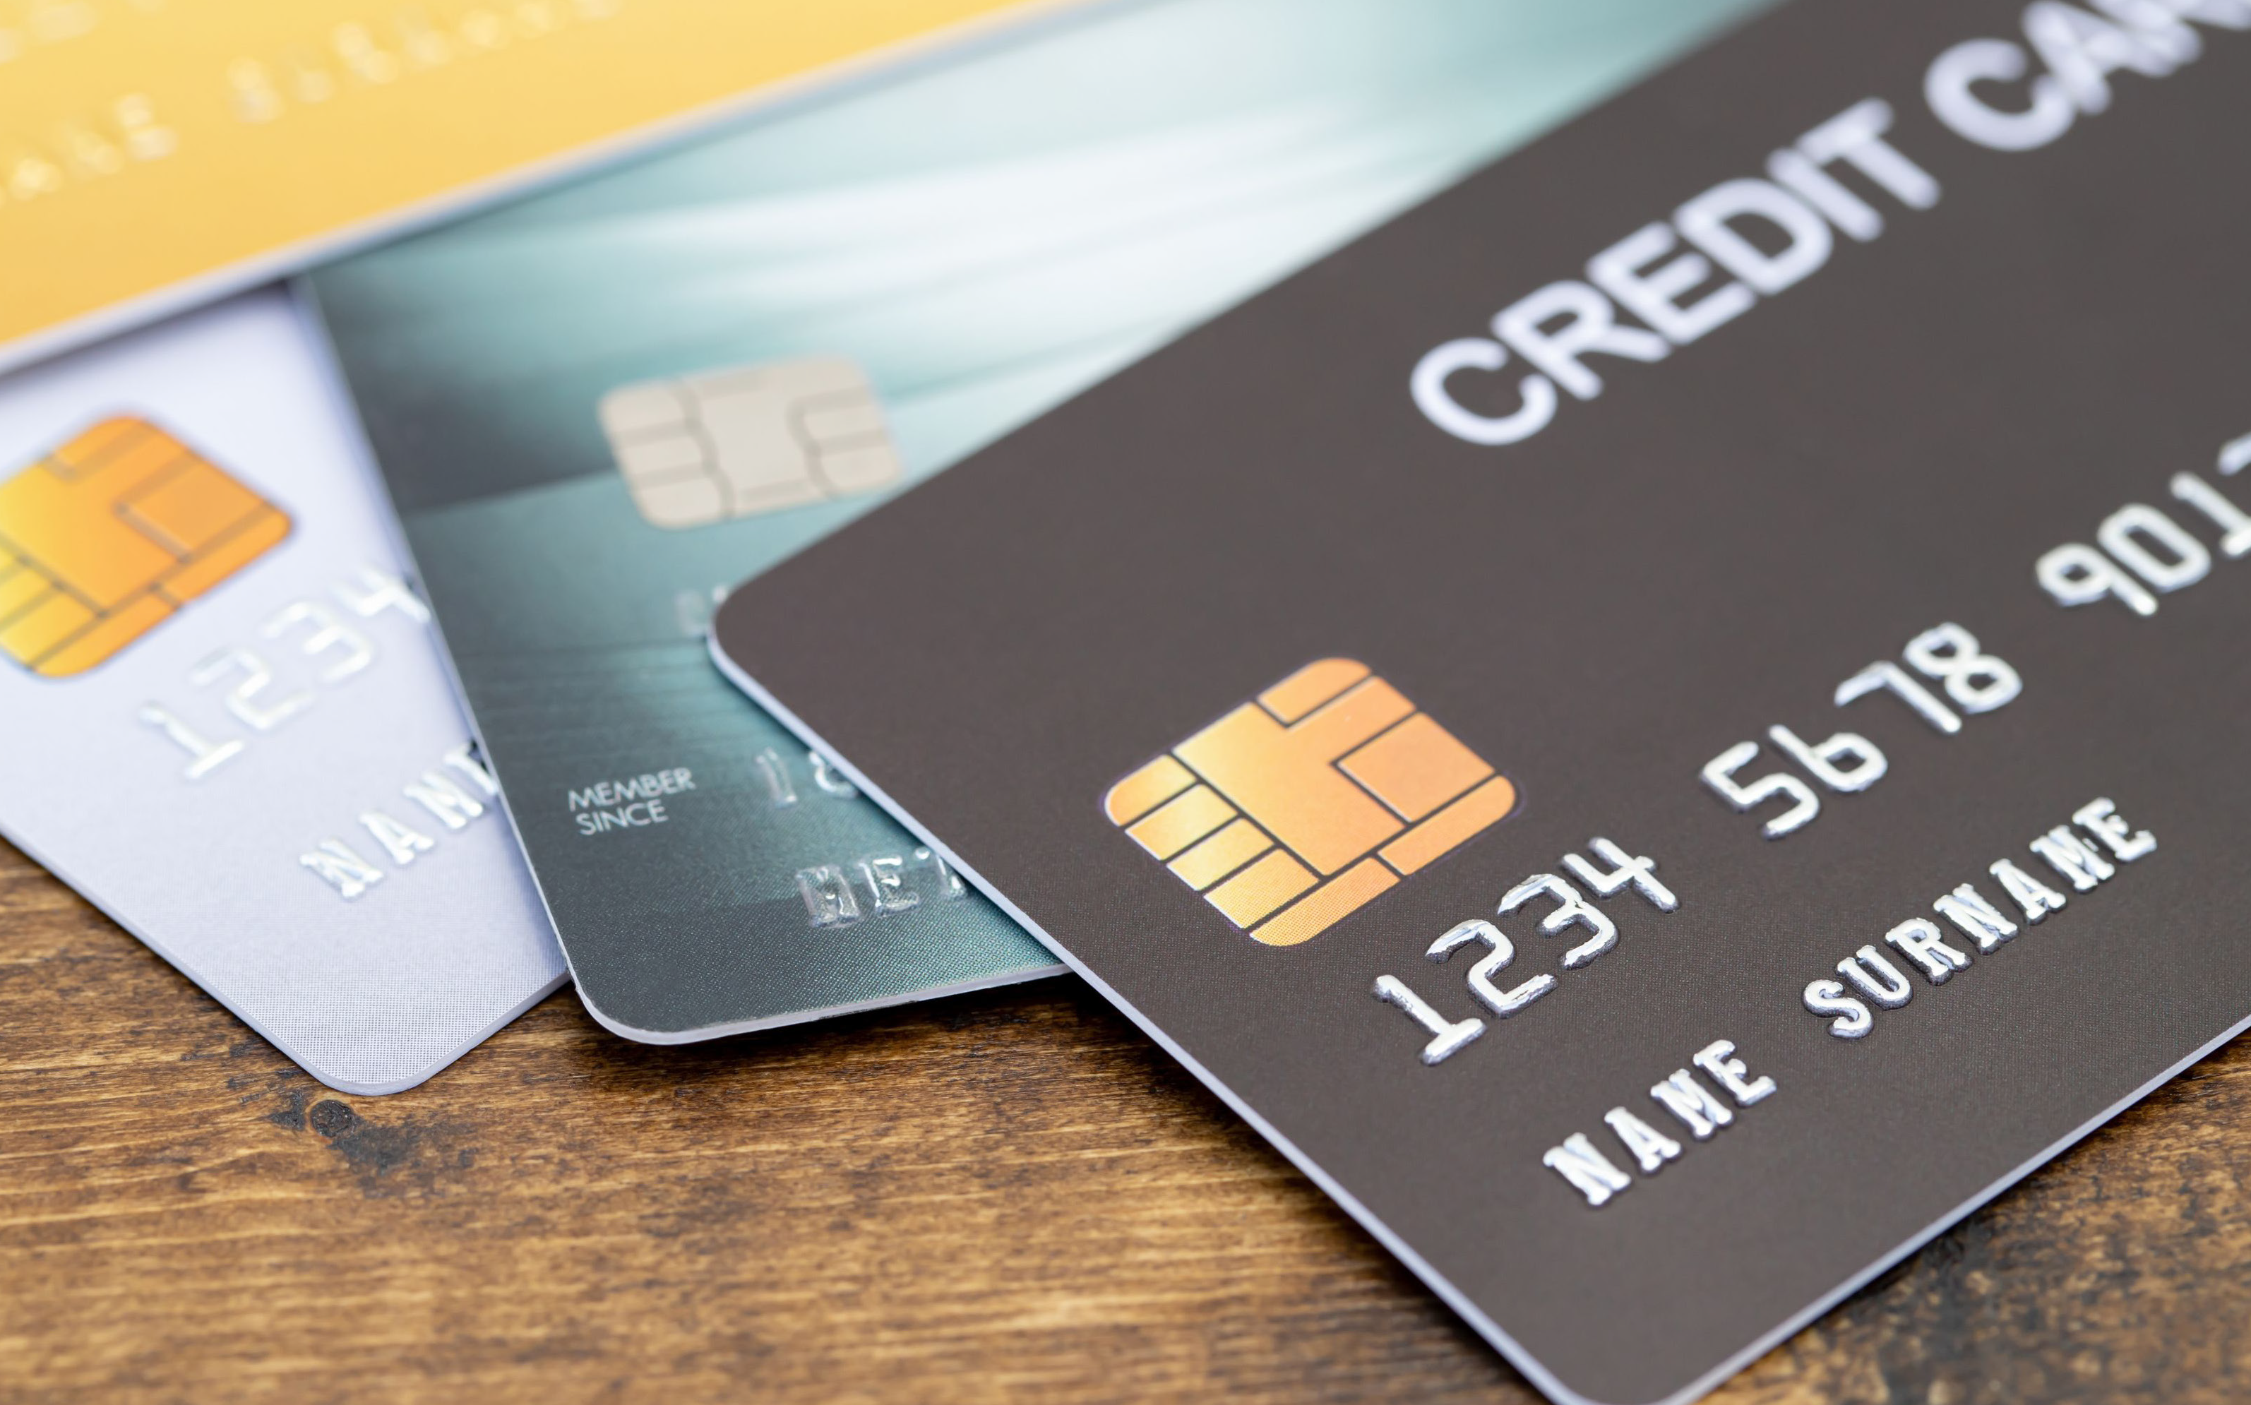
Learning About Credit and Debt
Notes:
Refer to the EZ-Reader Learning About Credit and Debt throughout the training.
This training will discuss how to manage your debt through credit and how to make sure you are paying back the money you owe.
A learning activity will towards the end of the training.
Please ask questions as we go through.

Slide 2
Learning Objectives
The participants will:
Identify the different types of credit
Describe how you get and manage a credit score
Summarize ways to pay back debt
Notes:
Credit and Debt--What does that mean? You have learned about how you get income and how you pay for your expenses. What do you do if you do not have enough money to pay for something?
In the training today, we will talk about:
Different types of credit
how to get and manage a credit score
The importance of paying back debt

Slide 3
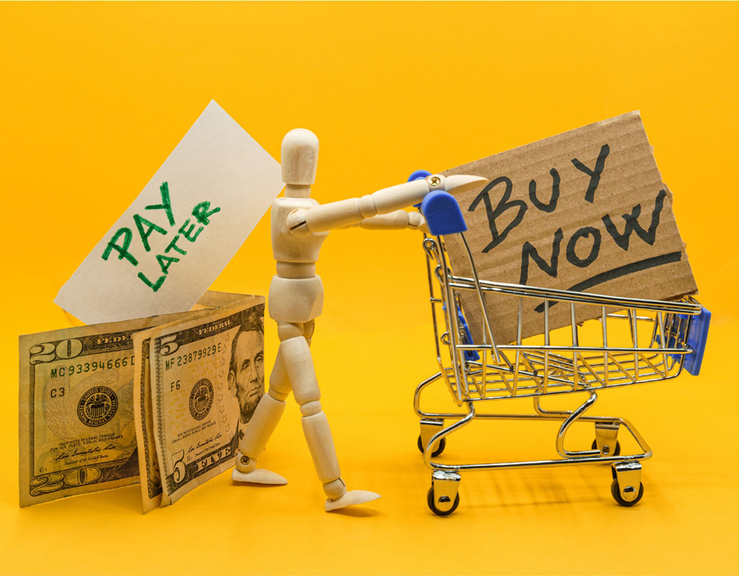
What is Credit?
Credit means borrowing money to buy things with a promise to pay in the future.
Notes:
You have learned about how you get income and how you pay for your expenses, but what do you do if you need or want something, and you do not have enough money?
You can get credit.
Read Slide
Co-trainer say: The different types of credit we will talk about today are loans and credit cards.

Slide 4
Loan
A loan is a type of credit that allows you to borrow money for a large purchase like a house or a car.
Notes:
Read Slide

Slide 5
Credit Card
A credit card is a card used to purchase an item right now and make payments in the future.
Notes:
A credit card is a payment option that allows you to purchase items now and pay later.
Credit cards can be powerful tools that need to be used carefully.

Slide 6
Using a Credit Card
Credit cards can offer more secure options to purchasing items.
They can. . .
protect you from fraud.
eliminate the need to carry large amounts of cash.
Notes:
Read Slide

Slide 7
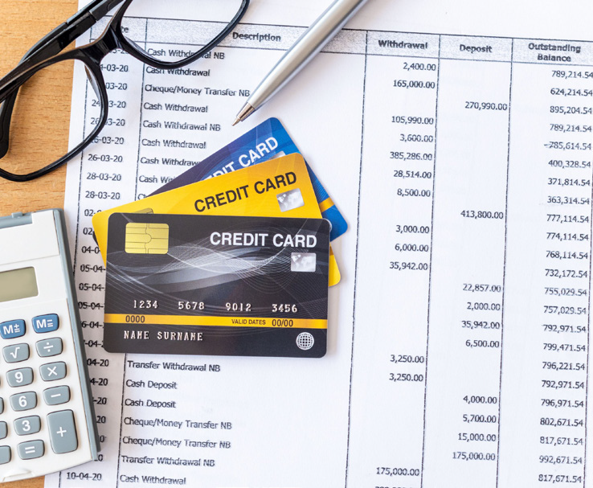
How Do You Pay for Credit?
It is important to have a plan to pay back the money before you use credit.
If you pay the amount borrowed during the pay period, you are not charged interest.
Notes:
How do you pay back the money (or credit) you borrowed?
Read Slide
Co-trainer can: Share examples of how credit is paid back. (if comfortable, share personal examples)

Slide 8
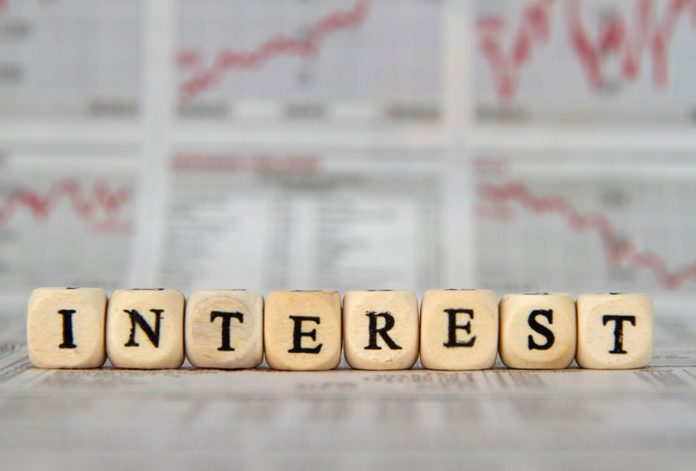
Interest is. . .
an extra cost you pay when borrowing money using credit.
the cost of borrowing money from banks or credit card companies.
Notes:
If you are not able to pay back the money you borrowed within a time period, you will be charged Interest.
Read Slide

Slide 9
Interest is based on:
How much money you make.
How much money you borrow.
Your credit score.
Notes:
Read Slide
We will talk about credit score later in the training.

Slide 10
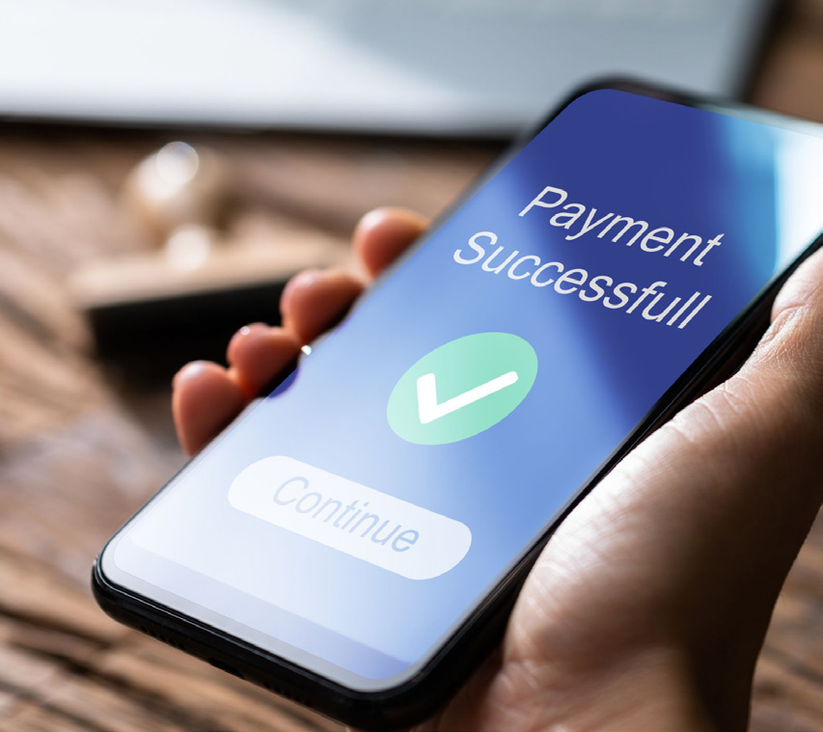
Interest is added to the amount you borrowed.
Notes:
Read Slide
Quickly paying back the money you owe means you will pay less interest.

Slide 11
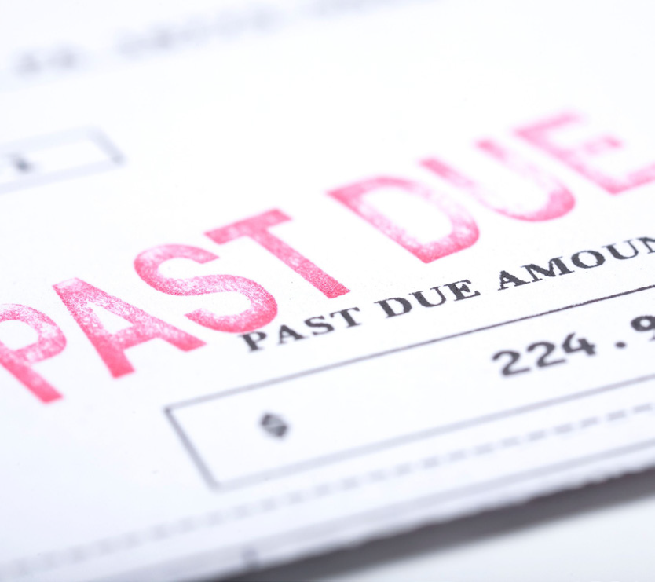
Late Fees
A late fee is extra money the credit company charges for not making credit payments on time.
Notes:
It is important to make credit payments on time.
A late fee is charged if you make late credit payments or skip payments.

Slide 12
How Do You Get Credit?
Notes:
Any person can apply for credit. The bank or business will determine if they extend credit to you based on your credit score and credit history.
Co-trainer can: Share examples of credit you have applied for if comfortable.

Slide 13
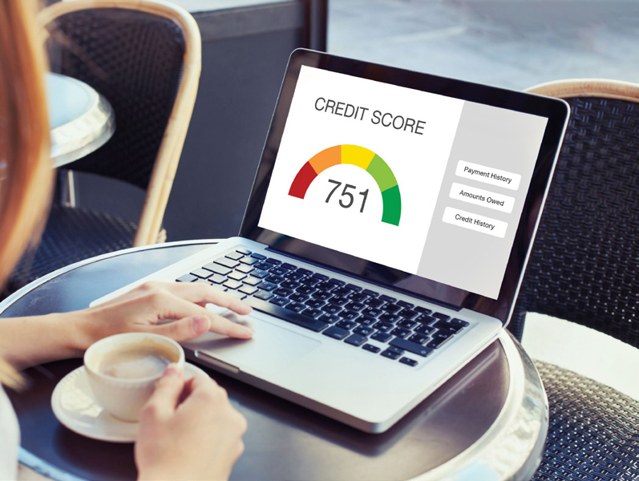
Credit Score
A credit score is a number that grades you on how well you pay back what you owe.
Everyone has a credit score if they take out a loan or use a credit card to pay for things.
Notes:
Read Slide
Your credit score can change anytime based on how you use credit. The higher your score the more likely you are to receive the credit amount. If you have a low credit score, you may not be able to get the credit amount OR the credit card company will charge a higher interest rate.

Slide 14
Who Has a Credit Score?
Everyone has a credit score if they make payments on a:
Loan
Credit card
Notes:
Read Slide
Your credit score will be checked when you apply for credit.
A good credit score or credit history will help you get a loan or credit card.

Slide 15
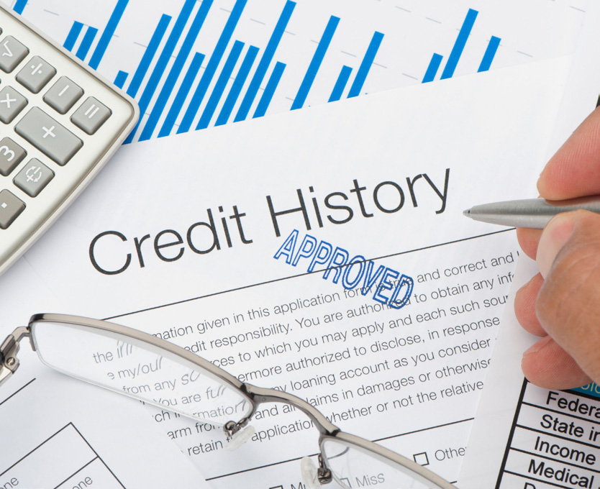
Credit History
Credit history is a record of how debt and money is handled.
Your credit history will show the loans and credit cards you are using.
Notes:
Read Slide
A bank or business will look at your credit history when you apply for a loan or credit. A credit history reports on how you have handled money in the past.

Slide 16
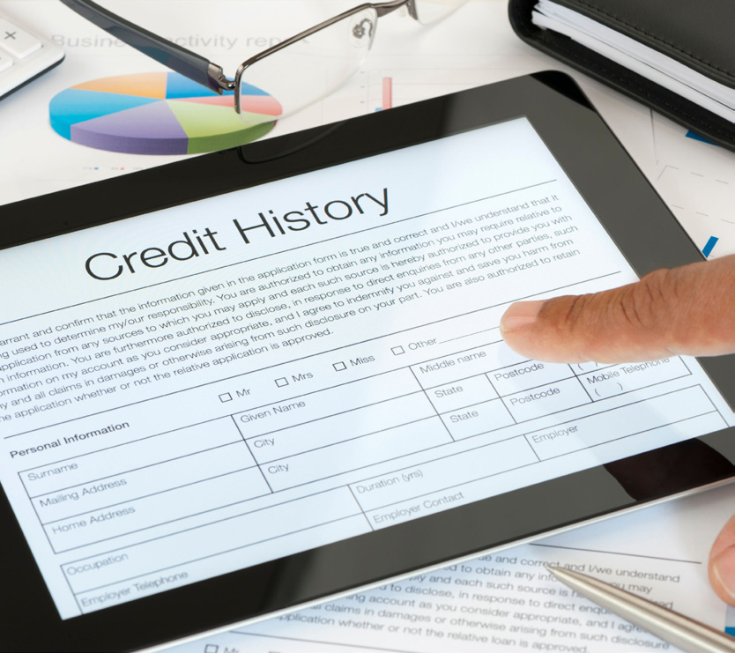
Your credit history includes information on:
How quickly you pay off credit cards and loans.
How you have paid other bills, like rent and utilities.
Your total outstanding debts.
Your available credit on lines of credit, loans and credit cards.
Notes:
Your credit history determines your credit score.
Making payments on time will build your credit history.
Read Slide

Slide 17
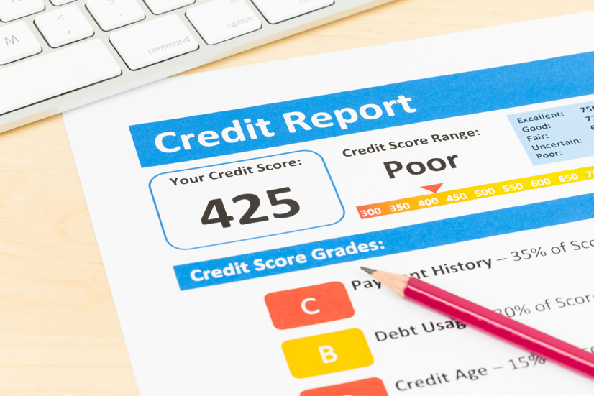
What Helps My Credit Score?
Your credit score goes up if you pay your bills on time.
A higher score can help you when you want or need to borrow money.
A higher score can help get a lower interest rate when borrowing money.
Notes:
Your credit score changes when you pay off debt or take on new debt.
Read Slide

Slide 18
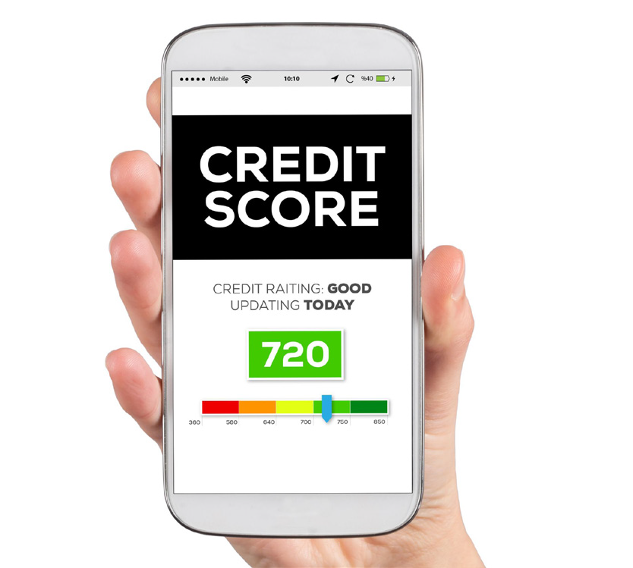
What Hurts My Credit Score?
Your credit score goes down if you miss payments or do not pay your bills.
This can make it harder to borrow money in the future.
It can also cause a higher interest rate when borrowing money.
Notes:
Read Slide
It is important to always pay off your debt or make monthly payments to keep your credit score high.

Slide 19
What is Debt?
Notes:
Every person who borrows money has debt.

Slide 20
Debt
Debt is an amount of money you owe to a person, bank or business that you have not paid back yet.
Notes:
Read Slide
You must pay back the debt you owe.
You might have to give back what you bought with credit if you do not pay your debt.

Slide 21
Types of Debt
Some debt you choose:
Student loan
Car loan
Credit card
Notes:
Read Slide
You can choose to take out a student loan or a car loan.
You can choose to buy things with a credit card.
Co-trainer can: share other examples of debt.

Slide 22
Unexpected Debt
Some debt is unexpected. This can be hard to plan for.
Home repair
Hospital visit
Notes:
Read Slide
Unexpected debt could be needing a loan or using a credit card to pay for a home repair.
Unexpected debt could be from getting sick and being in the hospital.
Co-trainer can: share other examples of debt.

Slide 23
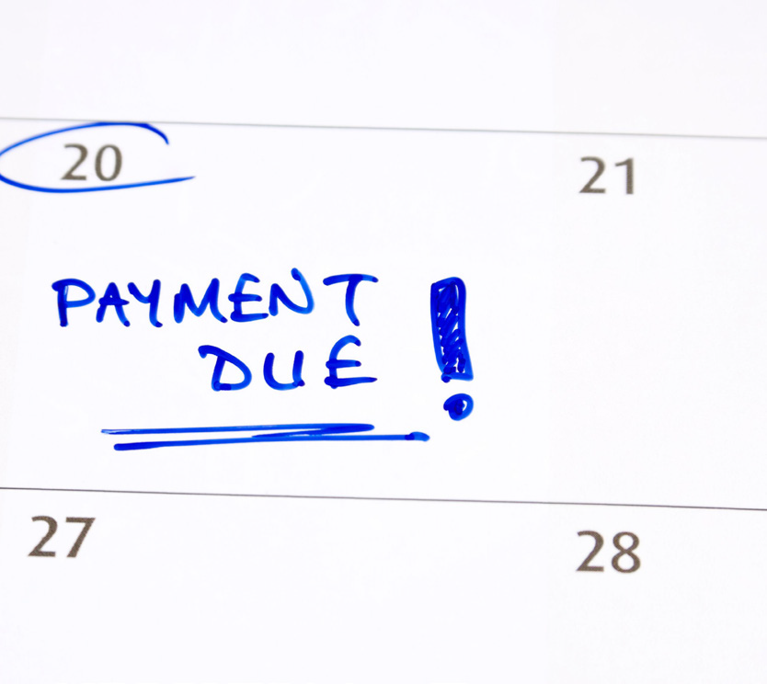
Paying Back Debt
You should plan on making payments on your debt just like your other bills.
Notes:
It is helpful to plan how to pay back your debt.
The longer it takes you to pay off debt, the more you may end up paying.
Read slide

Slide 24
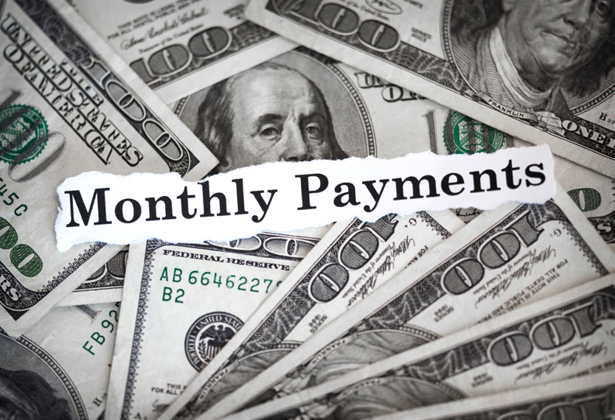
How Much Should I Pay?
Loans you. . .
pay the same amount each month.
can add extra money to your payments.
Notes:
Read Slide
Paying extra will help pay your loan and get out of debt faster.

Slide 25
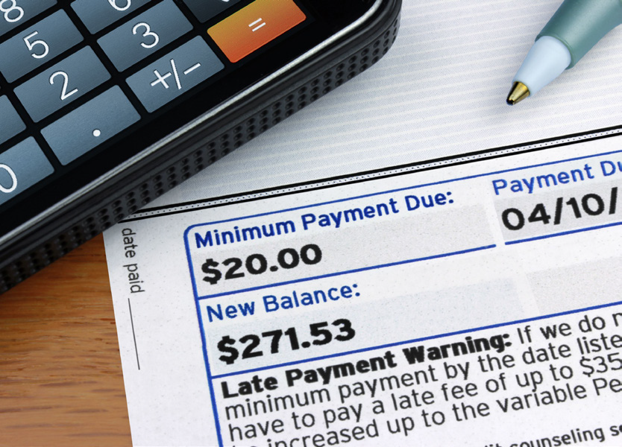
How Much Should I Pay?
Credit cards you. . .
can pay the full amount each month.
must pay the minimum amount each month.
Notes:
Read Slide
The minimum amount means you pay at least that much or get a late fee added to your debt.
The minimum amount can change based on how much you still owe.
Interest will be charged to your credit card when you only pay the minimum payment.
Paying more than the minimum payment will pay off your debt faster.

Slide 26
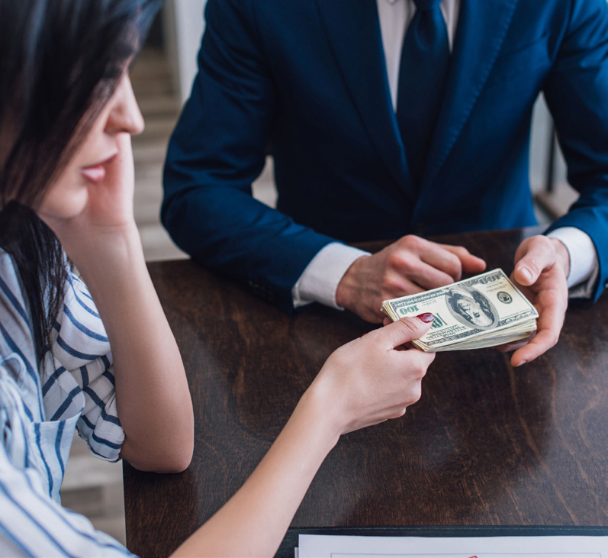
Debt Collection
Your debt may be sent to a debt collector if you get behind on making payments.
Notes:
The debt collector contacts you if you do not pay.
Your credit score will go down, and it will be harder to get credit in the future.
Co-trainer can explain who a debt collector is. A debt collector is a person or company that collects debts owed to others.

Slide 27
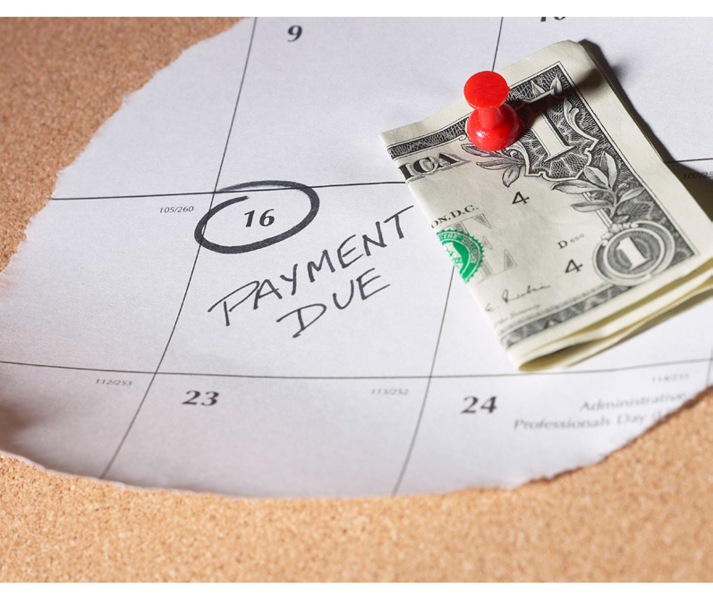
Reminders
Be careful with how much debt you have.
It is important to make payments on time.
Pay off debt as quickly as you can.
Notes:
Read Slide

Slide 28
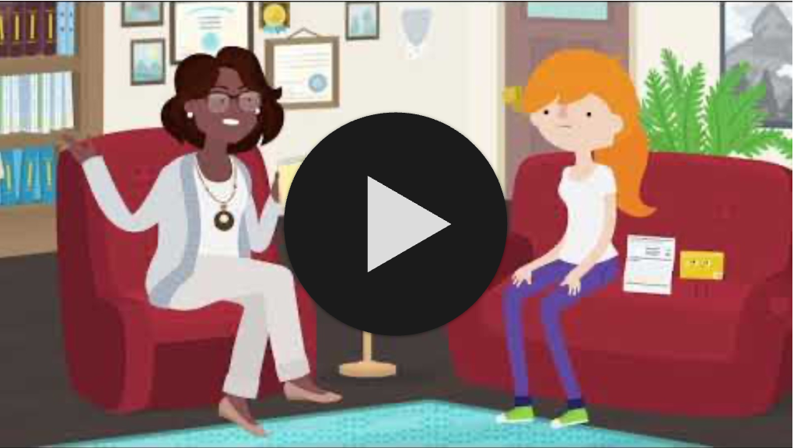
Using Your Credit Card
Ctrl + Click on the image to watch the video on YouTube!
Notes:
This video reviews:
How to use your credit card
How and when you pay back the amount you borrowed
Interest and late fees are additional money added to your bill if you do not pay off the total amount
https://youtu.be/MswDrhLtU_8?feature=shared (3:24)

Slide 29
Understanding Minimum Payment
It is important to understand the additional fees that go along with using a credit card.
Refer to the Minimum Payment's worksheet to learn more about credit card payments.
Notes:
Read the slide and refer to the worksheet to complete.
Put the participants in groups or work as a whole group based on numbers.
Read through the scenario, review the chart about Nathan’s credit card payments and answer the questions on the worksheet.
Give the groups 10 minutes to complete the activity.
Pull the group back together to share out what their group determined
Co-trainer can help groups talk through and complete the learning activity.

Slide 30
Resources
Practical Money Guide: Credit Card Basics
https://www.practicalmoneyskills.com/en/resources/free_materials/practical_money_guide-credit_card_basics.html
Loans 101 (video)
https://www.youtube.com/watch?v=fuiiJuB7tJs
Credit Scores and Reports 101 (video)
https://www.youtube.com/watch?v=71iaNlskCc0
Using Your Credit Card (video)
https://youtu.be/MswDrhLtU_8?feature=shared
Understanding Credit Cards
https://onestop.uc.edu/money/credit-cards.html
Notes:
These resources were used to create this training.
It is important to understand credit and debt. Understanding what it means to borrow money and pay it back.
This training goes along with the EZ-Reader Learning About Credit and Debt.
Thank you for joining us.

Slide 31
Acknowledgements: Community Life Guide: A Project of Ohio Department of Developmental Disabilities. Developed by Altarum and Life Course Nexus Training and Technical Assistance Center, UMKC institutes for Human Development, UCEDD

