Slide 1
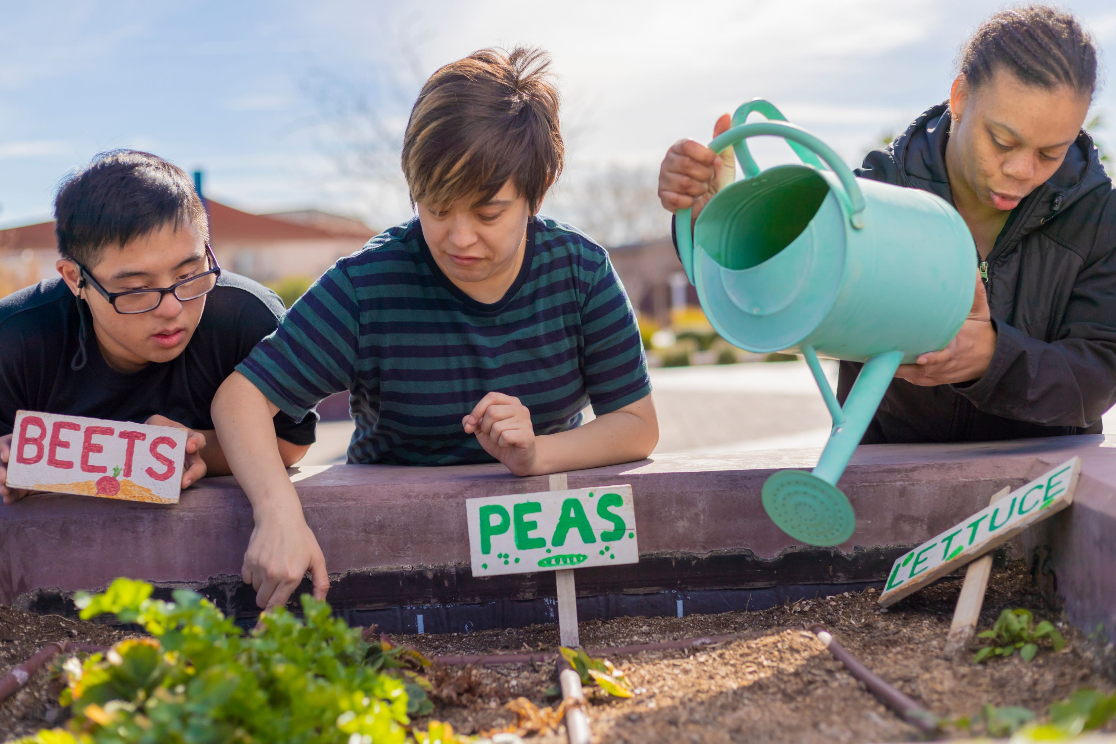
Everyday Health Care Routines
Notes:
Refer to EZ-Reader Everyday Health Care Routines
This training will discuss understanding healthy routines.
We will refer to the EZ-Reader throughout the training.
A learning activity will be completed in the training.
Please ask questions as we go through.

Slide 2
Learning Objectives
The participants will:
Identify ways to organize health care
Prioritize how to manage medication
Describe healthy living
Notes:
In the training today, we will talk about:
Different ways to organize your health care through everyday routines
How to manage your medication
Healthy lifestyle through healthy eating, staying active and understanding your mental health
This looks differently for many people.

Slide 3
Everyday Adult Tasks
You will clean your house and do your laundry.
You will pay your bills and take care of your money.
Notes:
Everyday adult tasks look different for people.
What are some tasks you do around the house now?
Ex. Help clean room, unload dishwasher, etc.
As an adult, you will take care of your living space by yourself or with help.
Read Slide

Slide 4
Everyday Health Tasks
It is important to do as much as you can on your own.
You can manage your everyday tasks with help from others when you need or want it.
Notes:
As you become an adult, you will need to take care of your own everyday health care.
Read Slide

Slide 5
Regular Check-Ups
Regular visits with your doctor are important to keep you healthy.
Regular visits with your dentist and eye doctor are important.
Notes:
Taking care of your health through regular check ups is important.
Read Slide
You have talked about transitioning to adult health care in earlier trainings.
It is important to understand your health care.

Slide 6
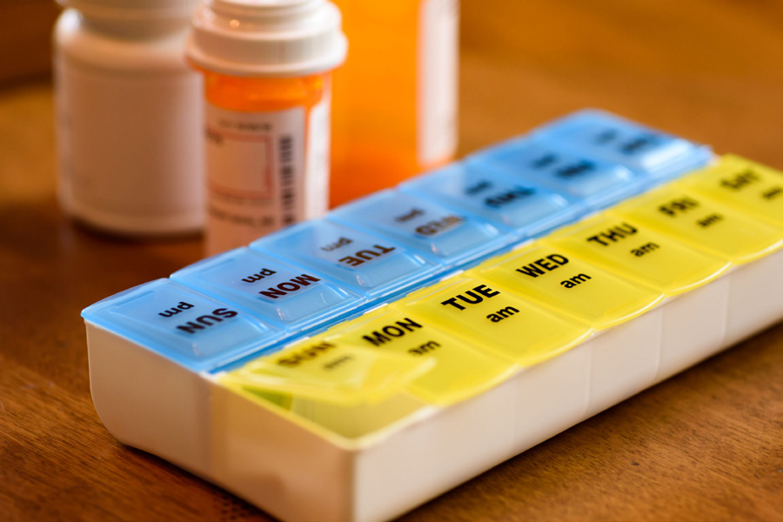
Take Your Medications
An important part of your health may be taking medications.
Notes:
Read Slide
Part of understanding your health is understanding what medication you take and why.
What does that look like in your everyday life?
How will you manage medications as an adult?

Slide 7
Getting Organized 1
A medication dispenser is one way to organize your medication.
You can buy medication dispensers in many stores.
Medication dispensers have compartments for each day and time.
Notes:
How do you organize your medication now?
Do you have a family member, support person, etc. help you take medication or manage medication?
Knowing how to organize your medication will help you become more independent when managing your medication
Read Slide

Slide 8
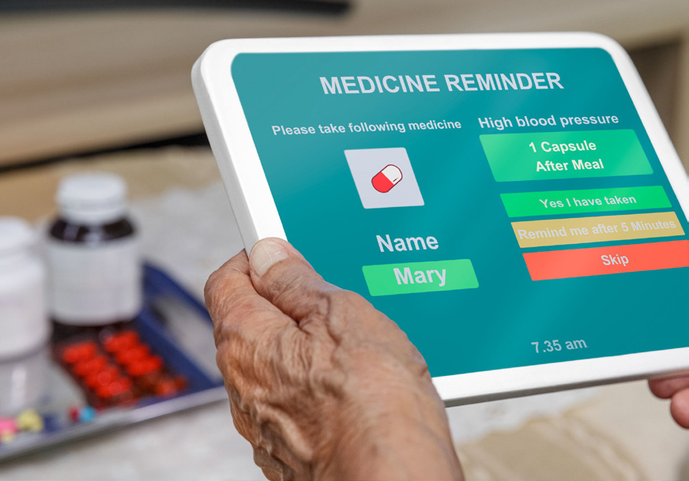
Getting Organized 2
Some medication dispensers are more “high tech.”
These medication dispensers can be set up to give out your medication at certain times.
Some medication dispensers have alarms or will text you to take the medication.
Notes:
Read Slide
Talk about other ways to organize medication.

Slide 9
Getting Refills
A pharmacy can set your prescriptions up to automatically refill.
Some pharmacies will even deliver them to your home.
Notes:
Getting prescription refills is another task you might need to do.
Read Slide

Slide 10
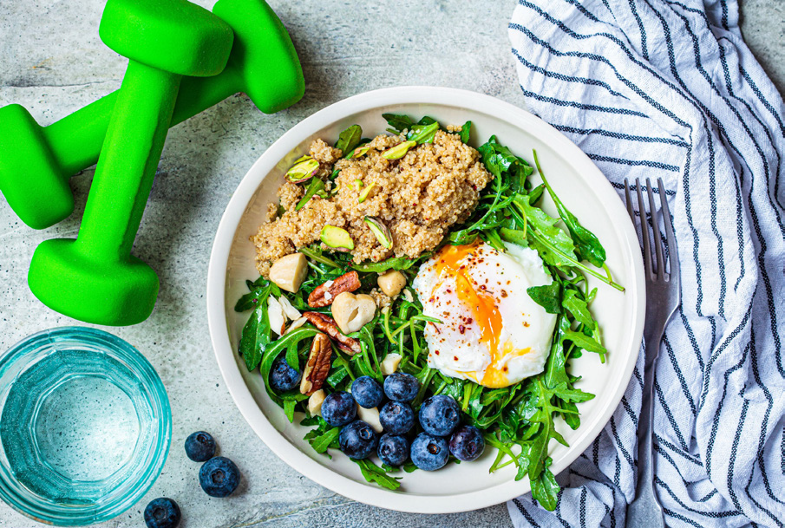
Healthy Eating 1
It is important to balance how much food and drink you take in with your activity level.
Notes:
Read Slide
Living a healthy life means paying attention to what you put in your body.

Slide 11
Healthy Eating 2
You should eat different kinds of foods to make sure your body gets what it needs.
Notes:
Read Slide

Slide 12
Healthy Eating 3
Part of healthy living is understanding the types of food you should eat everyday.
Food Groups
Fruits and Vegetables
Dairy
Protein
Grains
Notes:
Read Slide

Slide 13
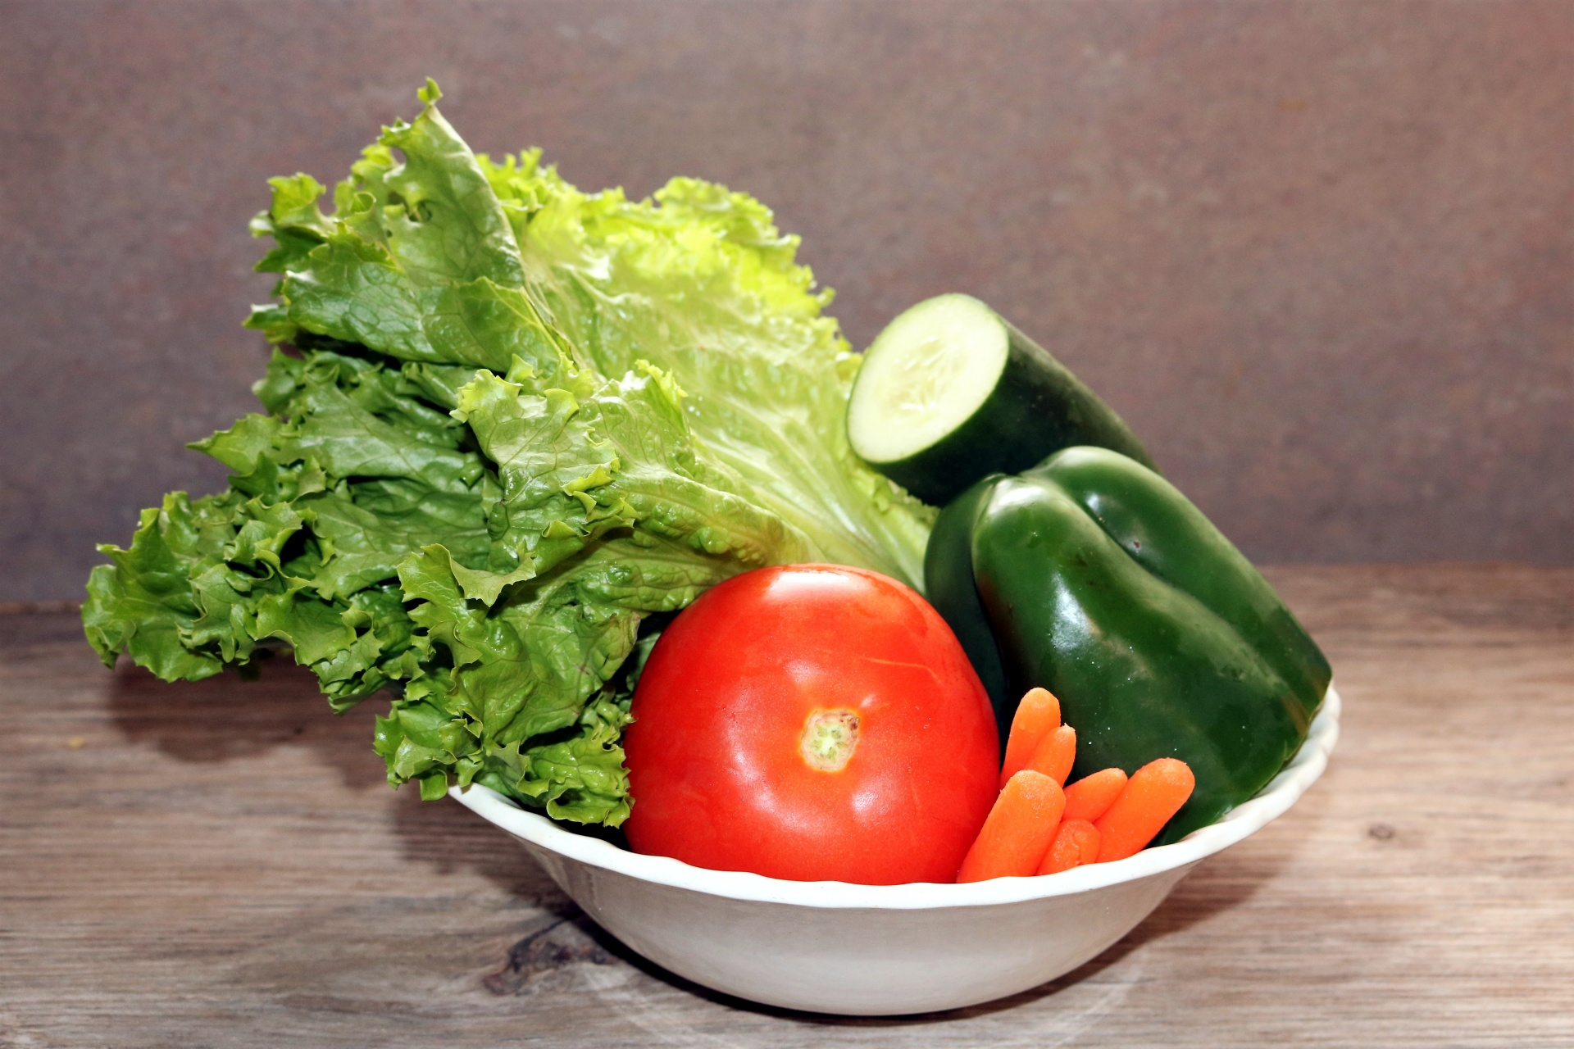
Vegetables
Vegetables are a source of vitamin A and potassium; they help with healthy skin and eyes. Examples of vegetables are spinach (leaf), asparagus (stem), potato (root), and artichoke (flower).
Examples of one vegetable serving:
2 cups raw leafy salad greens
1 cup cut-up vegetables
1 cup vegetable juice
Notes:
Read Slide

Slide 14
Fruits
Fruits are a key source of vitamin C and potassium; they help promote healing of wounds. Fruits can grow on trees, vines and bushes.
Examples of one fruit serving:
1 medium whole fruit
1 cup cut-up fruit
½ cup dried fruit
Notes:
Read Slide

Slide 15
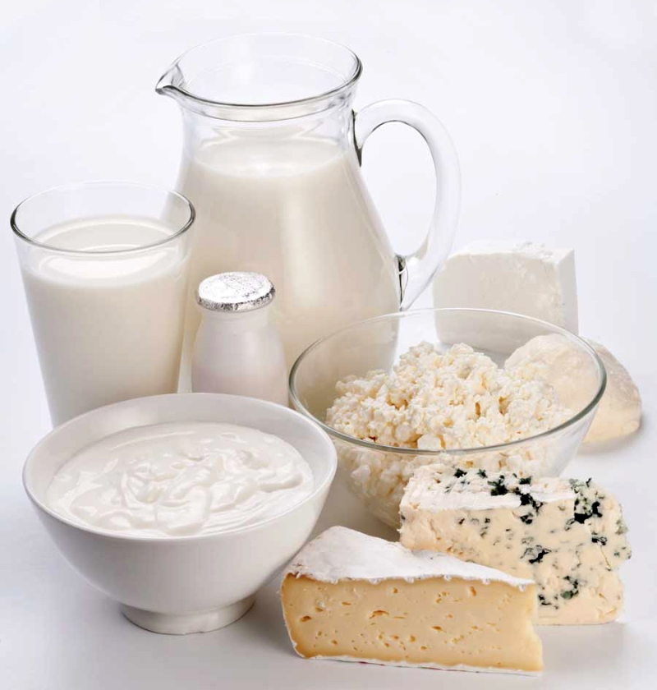
Dairy
Dairy provides a significant source of calcium and vitamin D; they help develop strong bones and teeth. The dairy group includes milk, yogurt and cheese.
Examples of one dairy serving:
1 cup milk
1 cup yogurt
1-ounce cheese
Notes:
Read Slide

Slide 16
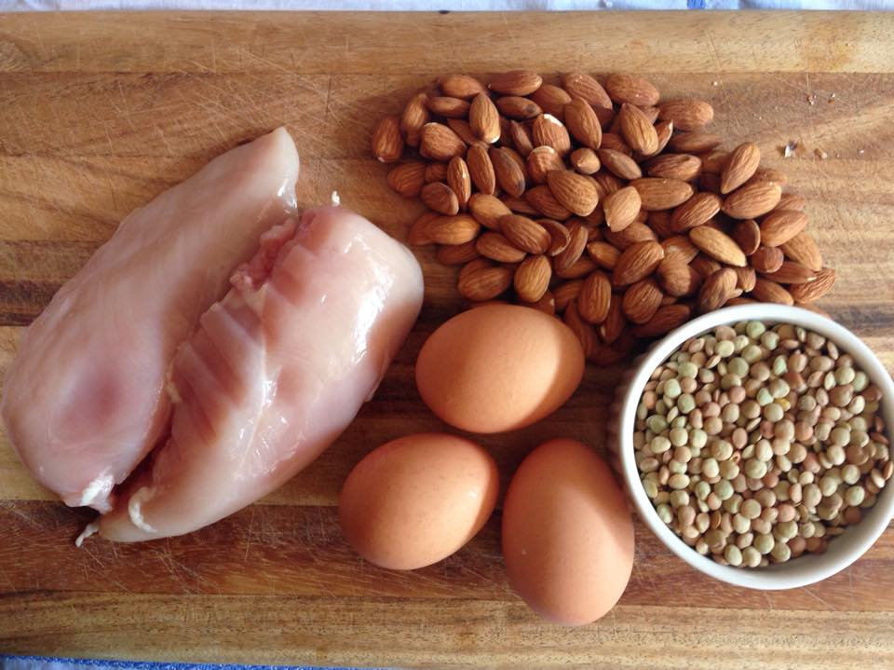
Protein
Protein helps build strong muscles. Chicken, fish, eggs, beans and nuts are examples of protein sources.
Examples of one ounce protein equivalents:
1 tablespoon peanut butter
1-ounce cooked seafood, meat or poultry
1 egg or 2 egg whites
Notes:
Read Slide

Slide 17
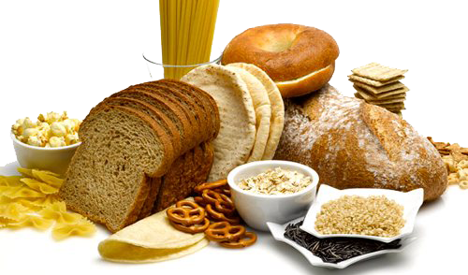
Grains
Grains are a key source of B-vitamins, which provide the body with energy. Whole grains provide more health benefits like fiber, which keeps the body feeling full longer.
Examples of one serving of grains:
1 slice bread
1 small tortilla
½ cup cooked rice, pasta or cereal
Notes:
Read Slide

Slide 18
Check Labels
Read the food labels to find out what is in the food and drink you buy.
Watch for how much salt, sugar and fats are in food or drinks.
Notes:
Read Slide
Foods that are more convenient or easy to make have high amounts of salt, sugar, and fats.

Slide 19
Grocery Store Tour
Notes:
www.youtube.com/watch?v=RjwfxfBPq3Y (1:58)
This video takes you through the grocery store. Highlighting areas with the healthiest food.

Slide 20
Staying Active
You can be physically active while doing house or yard work.
You can plan physical activities, like daily walks, sports, yoga or stretching.
Notes:
In addition to eating healthy, physical activity is very important.
Read Slide
Make physical activity a part of your day.

Slide 21
Why Is It Important?
Eating healthy can keep you from getting sick.
Eating healthy and being active keeps you strong and able to do things that are important to you.
Notes:
Eating healthy and being active will help you have a healthy weight.

Slide 22
Your Mental Health
Find ways to keep stress and anxiety from getting you down.
Don’t be afraid to ask for help or see a counselor when you need to.
Notes:
It is important to take care of your mental health as well as your physical health.
Read Slide

Slide 23
Your Healthy Life
Your health and wellness are key to living your best life.
The everyday things you do for your health are important.
You can start now to do more of those everyday things.
Notes:
Read Slide

Slide 24
Personal Strengths and Assets
Notes:
The Integrated Support Star looks at 5 areas and what support you may need in all.
Strengths: What are our own strengths or skills or assets? What can we use, learn, etc. to build capacity or support our needs?
Relationships: Who are the people in our lives? Who could help with one small thing?
Technology: Who doesn’t use technology these days? Technology can be high tech or low tech.
Community Supports: Where are places, groups or resources in the community you use or have access to?
Eligibility Supports: What (if any) supports do you receive? How can they help you transition to adult health care?

Slide 25
Healthy Living Support Options
Notes:
Here is an example of supports around health living.

Slide 26
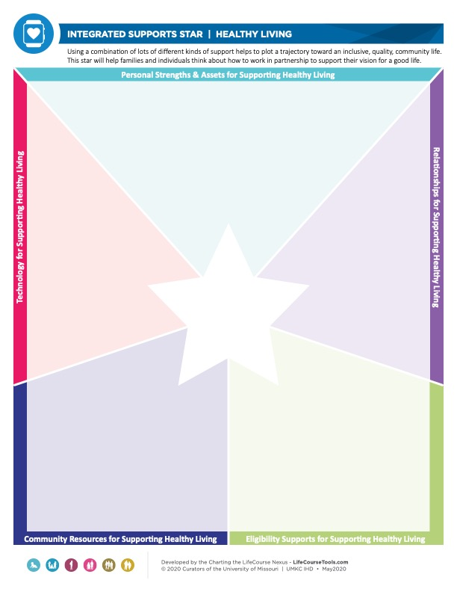
Integrated Supports Star
Complete the ISS to determine day to day supports for your health care.
Notes:
CtLC Integrated Supports Star (ISS)
The Healthy Living Integrated Supports Star helps you explore supports that can help reach your goals for living a healthy life.
The participants can complete this as a group to practice or break into smaller groups. Ideas can be shared, or you can discuss a scenario to have participants create a Healthy Living ISS.
List supports for day-to-day health care to help you in your daily routines.

Slide 27
Resources
9 Ways to Help Your Pharmacist Fill Your Prescription
www.goodrx.com/healthcare-access/pharmacies/ways-to-help-your-pharmacist-fill-your-prescription
Mayoclinichealthsystem.org –Shopping the Grocery Perimeter
www.youtube.com/watch?v=RjwfxfBPq3Y
5 Easy Ways to Find Healthier Options at the Grocery Store
https://www.heart.org/en/healthy-living/healthy-eating/cooking-skills/shopping/5-easy-ways-to-find-healthier-options-at-the-grocery-store
Notes:
These resources were used to create this training.
It is important to understand how healthy living can be put into your everyday routines.
This training goes along with the EZ-Reader Everyday Health Care Routines.
Thank you for joining us.

Slide 28
Resources Continued
Snap Ed NY - MyPlate Healthy Eating Style
www.youtube.com/watch?v=I4c2Q26Ihsw
Snap Ed NY – MyPlate Grains
www.youtube.com/watch?v=UVWz7MxnWJk
Charting the LifeCourse Integrated Support Star
https://www.lifecoursetools.com/lifecourse-library/foundational-tools/

Slide 29
Acknowledgments

