Slide 1
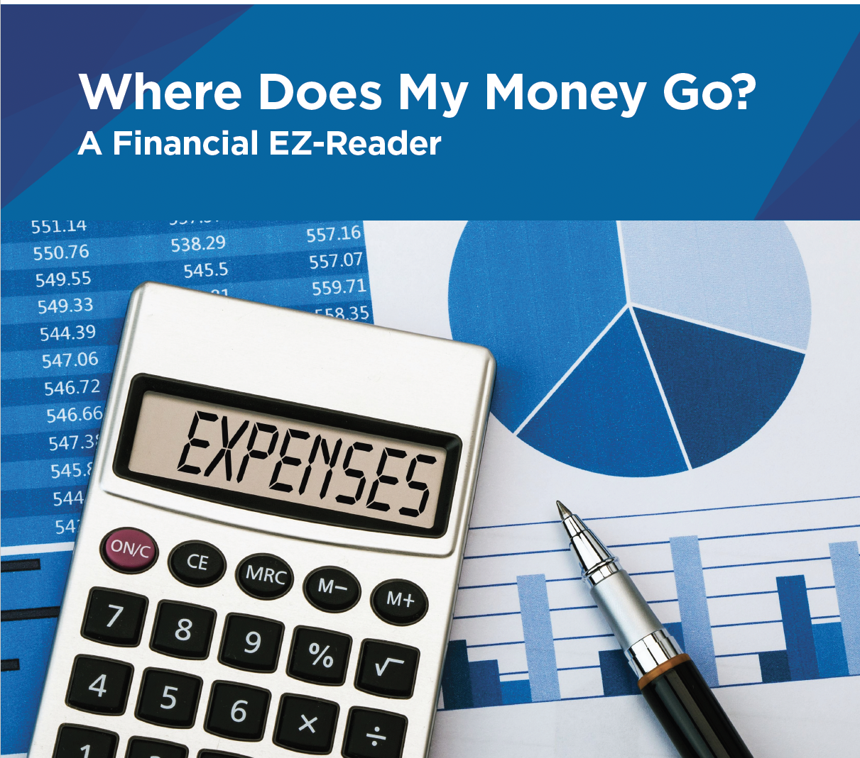
Where Does My Money Go?
Notes:
This training will discuss Expenses.
We will refer to the EZ-Reader Where Does My Money Go?
A learning activity will be in the training.
Please ask questions as we go through.

Slide 2
Learning Objectives
The participants will:
Identify the different types of expenses and ways to spend money
Compare similarities between paying with cash, check and debit card
Describe ways to pay expenses with a credit card
Notes:
In this training we will discuss. . .
Expenses
Fixed
Varied
Type of spending
Needs
Wants
Types of payment methods
Cash
Check
Debit card
Credit card
Automatic payment and how it is helpful

Slide 3
Having money is an important part of life as an adult.
What do you spend money on?
Food
Housing
Entertainment
Notes:
Having money is important. You need money for many different things.
What do you spend money on?
**If participants do not share, begin reading slide and talking about each domain
Food—groceries, McDonald’s, etc.
Housing—rent, heating bill, water bill, etc.
Entertainment—going to the movies, garage sale shopping, etc.

Slide 4
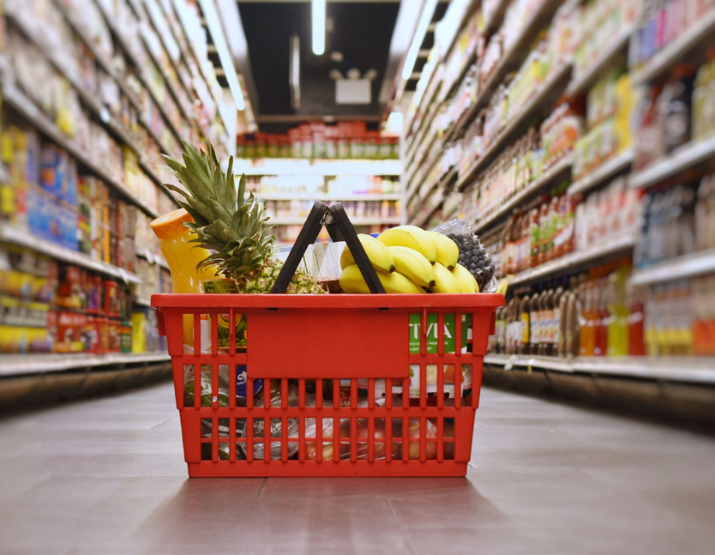
An expense is the money you spend to get something. It is the cost of something you buy or use.
Expenses can be:
Uber trips
Cell phone
Heat in your apartment
Notes:
You just shared some expenses. We know an expense is the money you spend to get something or do something.
Read Slide
Many of these ideas may have been shared earlier.

Slide 5
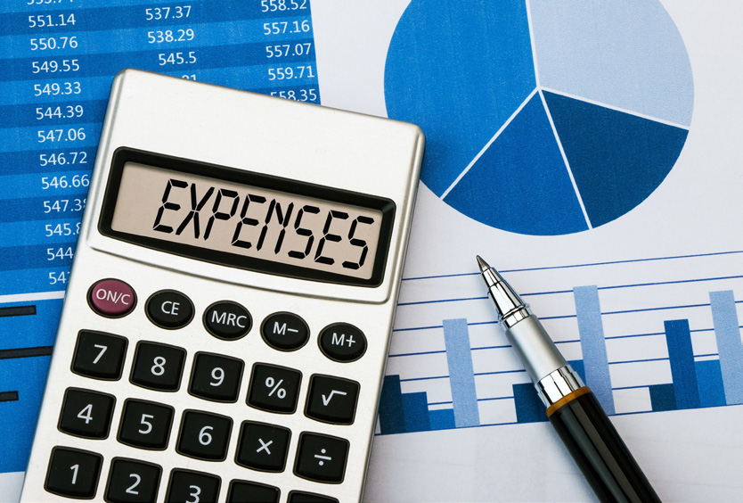
There are two kinds of expenses.
Fixed
Varied
Notes:
There are 2 types of expenses.
Fixed expenses stay the same.
Varied expenses change based on how much you use, what you buy, etc.

Slide 6
Fixed expenses stay the same every time.
Fixed expenses can be paid by the month, every week or every other week.
Notes:
Fixed expenses are always the same. You can plan for how much money you need each month.

Slide 7
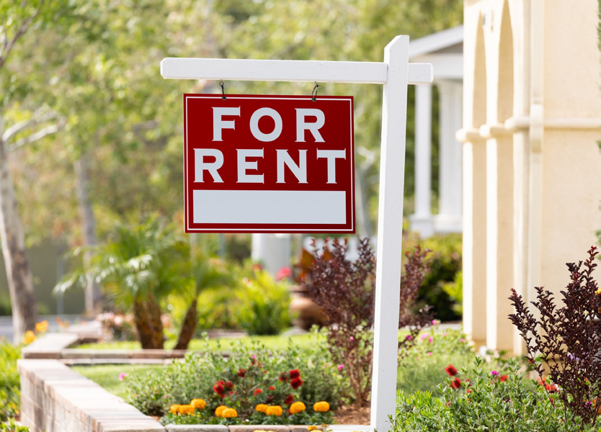
Fixed Expenses
Rent
Car loan
Cell phone service
Notes:
A fixed expense could be the amount of money you pay for rent each month. This amount does not change. The amount you pay for any kind of loan you get (car, house, etc.) does not change each month.
What other fixed expenses can you think of?

Slide 8
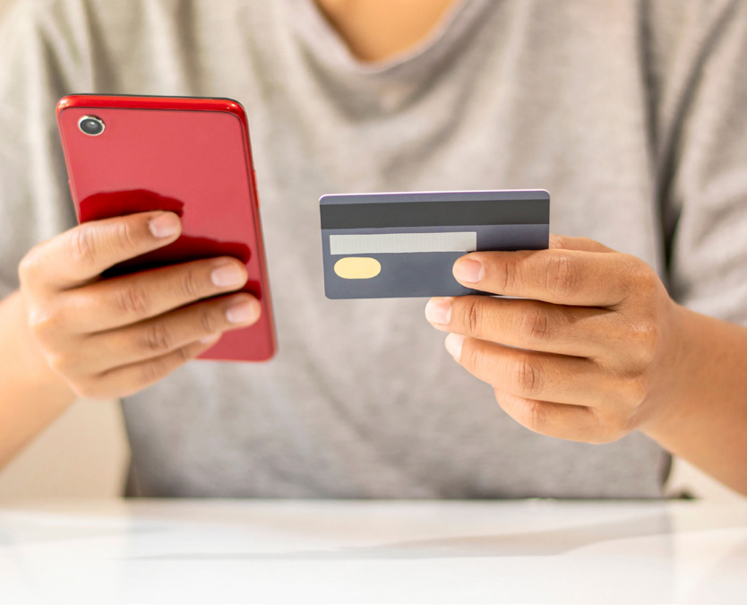
Varied expenses do not stay the same.
Varied expenses change based on how much you use or choices you make.
Notes:
Varied expenses are sometimes difficult to plan for each month.

Slide 9
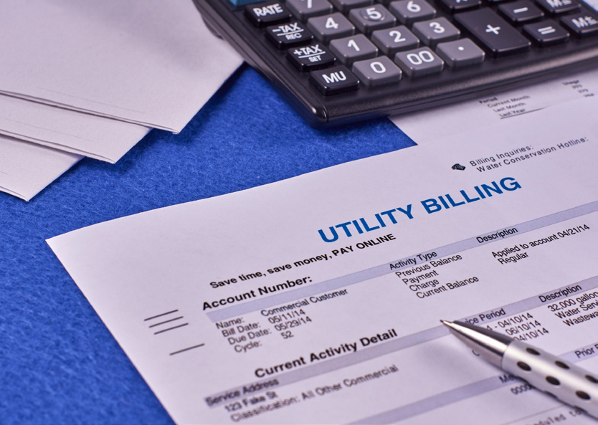
Varied Expenses
Grocery bill
Buying clothes
Utility payments
Heating bill
Water bill
Notes:
Other examples could be. . . going to the movies, going out to eat, etc.
What other varied expenses do you have?

Slide 10
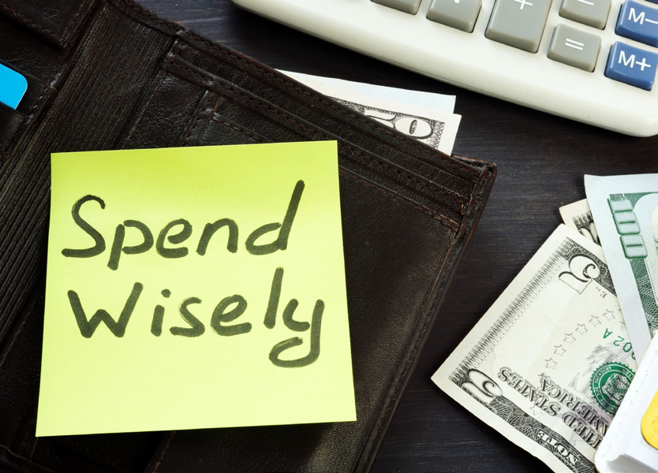
It is important to decide if you are spending your money on a need or a want.
Needs are things you must have for living or survival.
Wants are things that can make your life better or more enjoyable.
Notes:
Read slide
Needs are essential for living.
Wants are non-essential for living.

Slide 11
Needs
Food
Housing
Clothing
Notes:
What are other things you NEED to survive?
Needs can vary at times. You need clothing to protect you. Clothing can be in different expense levels.
Discuss different types of clothing. (i.e. name brand-Polo, compared to Old Navy)

Slide 12
Wants
Vacations
Jewelry
Video games
Notes:
What are things you WANT for your life? Wants can vary just like Needs.
You need food but you may want to go out to a restaurant each day. That can be very expensive. Buying food from a grocery store and planning meals can help reduce the cost of food.
Understanding the difference will help you make better decisions about how to spend your money.
Discuss different types of vacations. (i.e. travel to a beach vacation, compared to a camping vacation)

Slide 13
Need or Want?
Notes:
You have choices about what you spend your money on. Decisions need to be made on if what you want to buy is a need or a want.
Put the participants in groups to complete the Needs or Wants worksheets (or do all together). Do the Need or Want? Worksheet first to determine understanding. Move to Scenario’s worksheet.
Give the groups 10 minutes to complete the activity. Pull back together to share out.

Slide 14
How do you pay for things?
Notes:
Read Slide

Slide 15
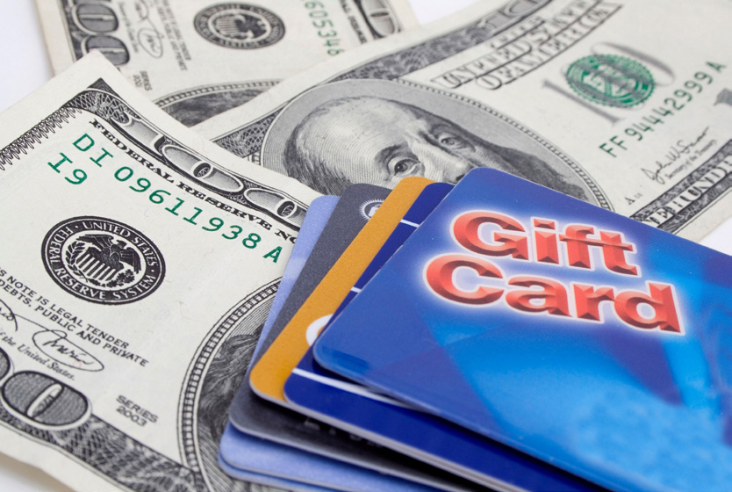
Once you know what you are spending money on, you can decide how you pay for things.
Cash
Debit
Credit
Notes:
Read Slide

Slide 16
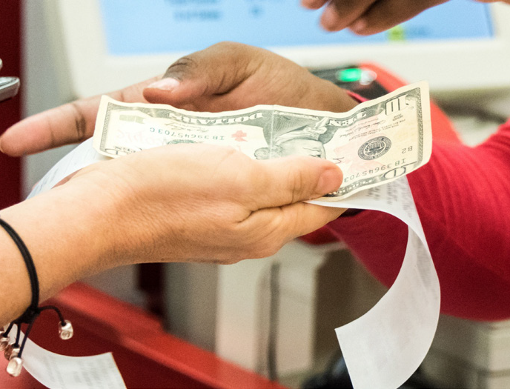
Cash
Paying with cash is usually used for smaller purchases.
Concession stand
Farmer’s market
Fast food
Clothing
Notes:
Paying with cash is usually only used for smaller purchases or expenses.
What are other things you can use cash for?

Slide 17
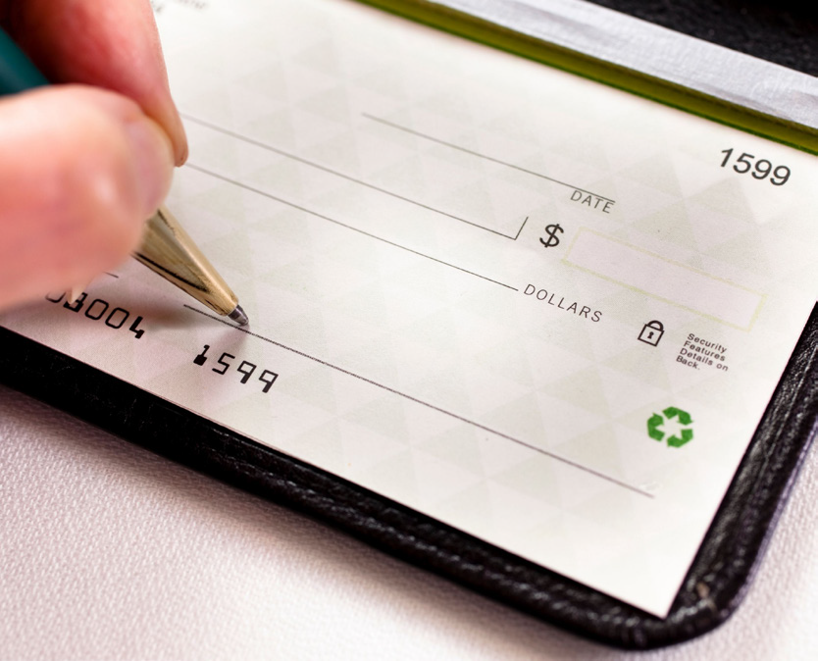
If you have a checking account at a bank, you can write a check or use a debit card.
The money comes out of your bank account.
Notes:
A Checking Account is a money account that allows deposits and withdrawals.
You can write a check to pay for items. The amount is pulled out of your bank account.
You must be careful not to spend more than you have in your bank account when using a check or debit card. This is called an overdraft. The bank will charge you an extra fee to cover the cost of what you purchased.

Slide 18
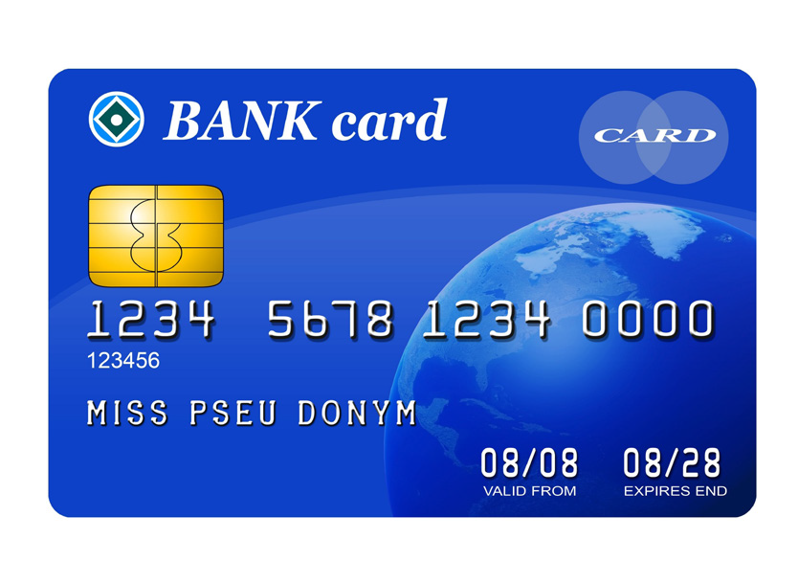
A debit card takes money right from your bank account to pay for things.
Notes:
Using a debit card takes money out of your bank account right away. It is like paying with cash. The money is immediately removed from your account.

Slide 19
A credit card is borrowing the money to buy things.
You must pay the credit card company back the amount you spent.
Notes:
Read slide
It is important to make payments on time each month. If you are not able to pay the total amount borrowed each month, the credit card company will charge you interest.
This is an additional fee to your total amount owed.

Slide 20
It is important to keep track of how you are spending money.
This helps with. . .
paying bills on time.
monitoring your spending.
Notes:
Having a budget or list of your expenses will monitor how you are spending money. This will reduce overspending. You can only spend what you bring in.
The EZ Reader on Budgeting will help explain how to make a list of all your expenses and how you will pay them each month.

Slide 21
Automatic bill payment is scheduling with your bank to pay bills each month.
Notes:
Work with your bank to set up payments that are automatically withdrawn from your account.
Once you set it up with your bank, it happens each month until you tell the bank to stop.
This is a great way to make sure your bills are paid on time.

Slide 22
Resources
Pacer Center – Printable sheet for your spending
https://www.pacer.org/publications/possibilities/images/stories/downloads/Managing_Your_Finances/Make_A_Spending_Plan/step_2_list_your_expenses.pdf
Helping Young People With Learning Disabilities Understand Money
https://arcuk.org.uk/wp-content/uploads/2013/05/Helping-young-people-with-learning-disabilities-to-understand-money.pdf
Notes:
These resources were used to create this training.
It is important to understand what you are spending money on. Understanding what is a need and what is a want is very important as you begin budgeting and paying your expenses.
This training goes along with the EZ-Reader Where Does My Money Go?
Thank you for joining us.

Slide 23
Acknowledgements: Community Life Guide: A Project of Ohio Department of Developmental Disabilities. Developed by Altarum and Life Course Nexus Training and Technical Assistance Center, UMKC institutes for Human Development, UCEDD

