Slide 1
Where Does My Money Come From?
Income Module
Notes:
The training will discuss ways to receive Income.
We will refer to the EZ-Reader Where Does My Money Come From? throughout the training.
A learning activity will be towards the end of the training.

Slide 2
Learning Objectives
The participants will:
Identify the differences between wages, salaries, tips and commission
List various employer-provided benefits
Describe different taxes taken from income
Provide examples of government-provided benefits
Notes:
Read slide
The Participants will:
Identify the differences between wages, salaries, tips and commission
List various employer-provided benefits
Describe different taxes taken from income
Provide examples of government-provided benefits

Slide 3
Becoming an Adult
There are a lot of changes that happen when you are an adult.
One of the changes is around money.
Notes:
When you were a child, what were some of the things you did?
Ideas to shout out if no one shares:
-played outside
-ate dinner with family
-went to school
What are some things you do as an adult?
Ideas to shout out if no one shares:
-get a job
-take care of my things (clean, laundry, etc.)
-budget income and expenses
We are going to talk about ways to earn income and how you may receive money.

Slide 4
You Need Money to Live On
This is called income.
You get income from:
A job
Gifts
Trusts
Government benefits
Notes:
Income is the money you have coming in. There are many ways to get money. You can get a job, receive gifts from family, friends, receive a special needs trust, and/or get government benefits.

Slide 5
How to Get Income
One way you can get income is by getting a job.
The kind of job you can get is based on what you know and what you are good at.
Notes:
How do you get income?
A job is a great way to receive income. Many people think about what they LIKE to do and look for jobs around that interest.
For example,
If you enjoy helping people, you could babysit, work in a daycare, work in the school setting, work in a retirement home, hospital, etc.
If you enjoy working with food, you could work in a restaurant, a grocery store, cafeteria in a specific setting (large building, school, college, etc.)
If you enjoy working around sports, you could work at the local ballpark, activity/community centers, etc.
Do not limit yourself. Think of an interest you have and research all the different jobs that would go with that interest.

Slide 6
Ways to Be Paid
Hourly
Salary
Tips
Commission
Seasonal
Job specific
Notes:
Once you have a job, there are many ways to be paid money.
Read slide

Slide 7
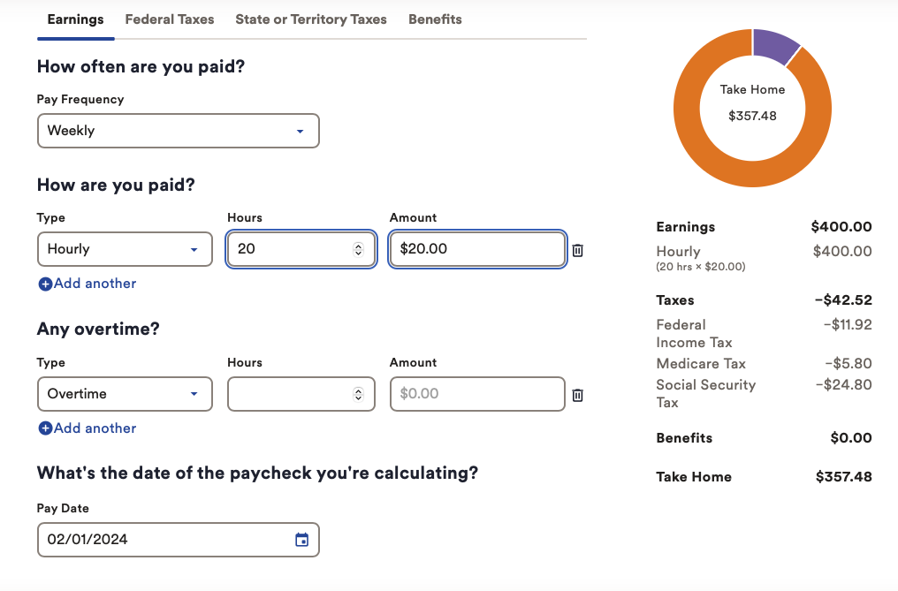
Hourly
An hourly wage is being paid a certain amount of money for each hour you work.
Ex. $7.00 an hour x 15 hours of work = $105.00
Many websites can help you calculate your total or gross pay.
https://www.adp.com/resources/tools/calculators/hourly-paycheck-calculator.aspx
Notes:
If you are working part-time or full-time, you could be paid with an hourly wage. This is where the employer offers you a specific wage for the time you work. For example, you work in the concession stand at the ballpark and are paid $7.00 an hour. You work 3 hours a day during a week. You work a 5-day work week. To figure out your weekly wage, multiply the number of hours you work each day (3) and the number of days in a week (5). 3 x 5 = 15. Once you have your total for the work week (15), multiply that by the amount you are being paid hourly ($7.00). (read example from slide--$7 x 15 = $105.) This is your gross pay. Gross pay is the total earnings during a pay period before any deductions are removed.
Facilitator Notes:
There are free websites that help you calculate what you make in a pay period. (click on the link) Add info from example into the calculator (image is screenshot from website).

Slide 8
Salary
Salary means you get paid the same amount for each pay period.
A pay period could be:
Weekly
Every 2 weeks
Monthly
Notes:
If you receive a Salary, the amount you are paid does not change no matter how many hours you work. You are paid a set amount yearly. That amount is split based on your pay period. You could be paid weekly, bi-weekly or monthly.
For example:
If you are paid $35,000 a year, you divide that amount based off your pay period.
Monthly--$35,000 / 12 months = $2,917
Bi-weekly--$35,000 / 26 weeks = $1,346
Weekly--$35,000 / 52 weeks = $673

Slide 9
Tips
A tip is an extra amount of money a customer gives because you do a good job. This is on top of your salary or hourly pay.
Jobs that get tips:
Server or waiter in a restaurant
Delivery driver
Hairdresser or barber
Notes:
Have you ever been to a restaurant and seen your parents or friends pay extra money when they receive the bill? This is a tip. You give a tip to someone that has done a great job providing service. A waiter/waitress will receive a tip when they have done a great job getting the orders for the table. Also, being friendly and social is important.
A tip is on top of the hourly rate of pay you receive from the employer.

Slide 10
Commission
A commission means you get paid additional money when you sell something.
Jobs that get commission:
Retail or store worker
Realtor
Car salesman
Notes:
Commission is very similar to a tip. If you are doing a great job at selling something, you may get a commission. A commission is an amount based on what was sold.
For example, some clothing stores pay their workers a commission based on what they sold to the customer. (Shirt, pants, shoes totaled $65.00. Commission could be 10% of $65.00. That is $6.50)
You could make an extra $6.50 in addition to your hourly wage.

Slide 11
Specific Jobs or Seasonal Work
Some businesses hire people to do work for a certain amount of time.
Jobs that hire for specific or seasonal work:
Yard work
Holiday help in a store
Amusement park
Notes:
A specific job or seasonal job could be a job you do to help someone or a job that only is for a specific amount of time.
For example,
Your neighbor needs help building a new fence. They offer to pay you $10.00 an hour to help them build the fence. This job will last until the fence is built.
The community ballpark has seasonal jobs during the summer season. You work the concession stand during their summer season. The job will last until the season is over. (May to August)
The local mall needs holiday workers to help during the holiday season. You work as a store clerk until the holiday season is over. (November to January)

Slide 12
Jobs with Flexible Hours
Jobs with flexible hours change when you want them to. Jobs with flexible hours pay you only when you work.
Jobs with flexible hours:
Driving for Uber or Lyft
DoorDash
Upwork
Notes:
Jobs that are more flexible are based on what you would like to do. These jobs are based on the time you have available. You set the schedule.
For example,
You could work for Doordash and only sign up for Saturday because you do not work your other job or you are not at school on Saturday.

Slide 13
People Who Own a Business
When you own a business, you are responsible for all the things that are needed to run your business. Money that you spend for your business is called “expenses.”
Expenses come out of the money you take in.
Notes:
When you own your own business, you are the boss. You get money from the job you do. You do not have an employer that gives you a paycheck. You often have clients or customers that pay you for the service you provide.
For example,
Lawn work
Babysitting
Selling items that you create (jewelry, pictures, etc.)

Slide 14
In addition to income, you can get benefits from a job.
Notes:
We just talked about ways to receive money. If you work for an employer or business, you will receive a paycheck. The employer or business can provide additional benefits that go along with your job.

Slide 15
Benefits
Benefits are things other than money you get from a job.
You can receive benefits when you work a certain number of hours, or you are paid a salary.
Insurance
Health
Dental
Life
Notes:
Benefits are provided by the employer. Some of the benefits may be covered by the employer and some may be taken out of your paycheck.
These benefits are DEDUCTED from your money you will receive.
Benefits can be insurance for medical coverage. This is very important and considered a benefit because it benefits you. There may be an amount taken from your paycheck, but it is for a medical coverage that may be needed in the future.

Slide 16
Benefits: Part 2
Medical spending accounts
Money is taken out of your paycheck to pay for health care.
Retirement
Part of your wages are put aside for a retirement plan.
Notes:
Other benefits that may be deducted from your paycheck are for a medical spending accounts or retirement. These are voluntary deductions, meaning you can say yes or no if you want the deduction taken from your paycheck.

Slide 17
Benefits: Part 3
Paid Time Off (PTO)
You continue to get wages when you take time off work.
Vacation time
Sick time
Paid holidays
Notes:
Paid Time Off is another benefit that is not deducted from your paycheck. It is provided once you work a certain amount of time. PTO can be used for sick leave, vacation or holidays.
PTO means you can take time off and still get paid.

Slide 18
Taxes
Notes:
We just talked about ways you receive money and additional benefits that go along with your job. Your employer will pay you but will also take out taxes based off the federal and state government.

Slide 19
Taxes are taken out of your paycheck.
Types of taxes everyone must pay:
Federal and state taxes
Social Security taxes
Notes:
Taxes are mandatory payments or charges collected by the state and the federal government. These taxes are used to cover the costs of general government services, goods, and activities. If you receive a paycheck, your employer or business must take out taxes.

Slide 20
Federal and state taxes help pay for things people in the community use like:
Roads
Parks
Police
Fire Department
Libraries
Schools
Notes:
Taxes are not all bad. They provided money for our community. Taxes pay the salary of our service providers (police, firefighter and teachers). Taxes pay to keep our roads repaired and our parks safe.

Slide 21
Social Security tax is used to pay money to people who have already retired and people with certain disabilities.
Notes:
Social Security is taken out of everyone’s paycheck. This tax will come back to you once you retire as well as provide support for certain disabilities.

Slide 22
Gross pay is total earnings during a pay period before any deductions are removed.
Net pay is earnings after all deductions are removed.
Notes:
Employer benefits and government taxes are important to understand when you are reviewing your check stub and your payroll check.
Your payroll check will show what you make before deductions (gross pay) and what you will receive after deductions (net pay). The Learning Activity in this training will go into more detail.

Slide 23
Know Your Paycheck
Ctrl + Click on the image to watch the video on YouTube!
Notes:
This is a video about a young man receiving his first payroll check.
Watch video https://www.youtube.com/watch?v=YB3tsZ24mF0
Once video is over. . .
How did the young man feel about his first paycheck?
What did the friends do to help?

Slide 24
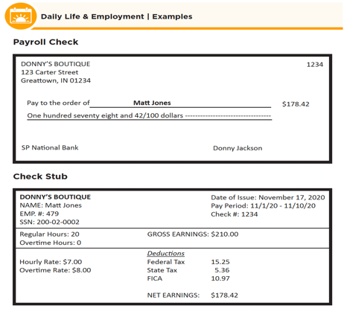
What Is on Your Paycheck?
Notes:
This learning activity is to help understand what is on your payroll check and check stub. Early, we talked about the jobs you could do and how you are paid (ex. hourly, salary, tips, etc.). You will receive a payroll check for the work you do and a check stub that lists all information about your check.
You could get a paper payroll check, or you might get a payroll check sent directly into your account through a direct deposit. You can work with your employer to set this up and to know how to see your check stub online.
Facilitator Notes: The participants will use the CtLC What is on Your Paycheck? (image on slide). This can be done as a whole group or split into smaller groups.
Learning Activity: Facilitator) Notes for Activity
CtLC What is on Your Paycheck?
Read through the first page.
Discuss the payroll check
Review the check stub
Answer the questions on first page.

Slide 25
Other Ways You Can Get Money
Gifts of money
Trusts
Government Benefit
Notes:
Other types of income or ways to receive money are:
Gifts from friends or family
Special Needs trust
Government Benefits

Slide 26
There Are Other Ways You Can Get Money
Gifts of money
Trusts
Government Benefit
Notes:
Other types of income or ways to receive money are:
Gifts from friends or family
Special Needs trust
Government Benefits

Slide 27
Gifts of Money
Your family or friends might give you money for a birthday or other special event.
Notes:
Gifts of money can be from your family or friends. They can be given to you for holidays, birthdays or for a big purchase.
Ex. Your family may want to give you money to help purchase a car.

Slide 28
Trusts
A special needs trust is a way for someone to give you money.
The money in this kind of trust does not keep you from getting public benefits.
Notes:
A special needs trust is a way family can put money in an account for you to use as you need it. This money does not prevent you from accessing your government benefits. This trust often pays for living expenses after government benefits has provided funding.
Example,
Medicaid has paid for a certain amount of health coverage. The trust will pay the remaining amount.

Slide 29
Government Benefits
Government benefits are benefits that help with living expenses.
Notes:
Government benefits are benefits that support certain disabilities.

Slide 30
Supplemental Security Income
Supplemental Security Income (SSI) is money that is paid every month to help you with living expenses and care.
Notes:
SSI is a set amount based on your income. SSI is money that can help with food, rent, clothing, etc.

Slide 31
Medicaid
Medicaid is is a health care program provided by the government to help pay for health care services.
People with disabilities and people with a low income can get Medicaid.
Notes:
Medicaid helps cover many medical expenses.

Slide 32
Supplemental Nutrition Assistance Program
(SNAP) is a program that can help you get nutritional food.
Notes:
The Supplemental Nutrition Assistance Program program or SNAP, covers nutritional food needed. This program is based on your income.

Slide 33
Department of Housing and Urban Development
HUD is a Housing Assistance program that gives you a coupon to help pay your rent.
Notes:
Department of Housing and Urban Development or HUD, is a housing assistance program through the government. This program helps find appropriate housing based on your income.

Slide 34
Resources
Pacer Center- Printable sheet to list your income
https://www.pacer.org/publications/possibilities/images/stories/downloads/Managing_Your_Finances/Make_A_Spending_Plan/step_1_list_your_income.pdf
Payroll Calculator
https://www.adp.com/resources/tools/calculators/hourly-paycheck-calculator.aspx
YouTube Video: Know Your Paycheck
https://www.youtube.com/watch?v=YB3tsZ24mF0
Notes:
The information provided in this training is based on the resources listed. The resources may help you as you learn more about income and how working can provide multiple benefits.
This training goes along with the EZ-Reader Where Does My Money Come From?
Thank you for joining us.

Slide 35
Acknowledgements: Community Life Guide: A Project of Ohio Department of Developmental Disabilities. Developed by Altarum and Life Course Nexus Training and Technical Assistance Center, UMKC institutes for Human Development, UCEDD

