Slide 1
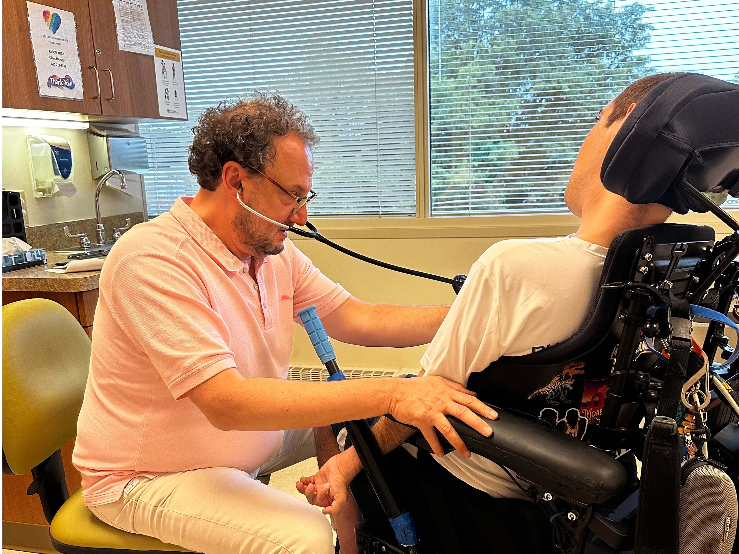
Leading Health Care Visits
Notes:
This training will discuss leading your health care visits as you transition to adult health care. This training is meant to help you explore ways you can take charge of your own health care visits in your adult life. This training goes along with the EZ-Reader Leading Health Care Visits.

Slide 2
Learning Objectives
The participant will:
Define what it means to be a self-advocate for adult health care
Identify ways to get ready for a health care visit
Create a one-page description to prepare for adult health care
Notes:
In the training today, we will talk about:
What it means to be a self-advocate for your adult health care.
Ways to prepare for a health care visit.
How to be a self-advocate and share your health care information as an adult.
This looks differently for many people.

Slide 3
Leading Your Health Care Visits
You will have a bigger role in your health care visits as an adult.
The biggest role will be as an advocate for yourself and your health care.
Notes:
Read Slide

Slide 4
What Does It Mean to Be a Self-Advocate?
Self-advocacy means speaking up for yourself and telling others how you need to be supported.
Notes:
Read Slide
Self-advocacy is the ability to communicate your needs.

Slide 5
Self-Advocacy in Health Care
Self-advocacy is important in your adult health care.
Speak up for what you need when talking to health care professionals.
Notes:
Read Slide
Do not let others speak for you unless you ask them to do so.

Slide 6
Setting Up a Health Care Visit
Schedule a time that works for you.
Let the scheduler know if you need a longer time for your visit.
Ask for a reminder call, text or email before your visit.
Notes:
To start advocating for yourself, set up your health care visit if you are able.
Ask for a time that works best for you when scheduling your doctor visit.
Let the scheduler know if you need a longer time for your visit.
Ask for a reminder call, text, or email before your visit.

Slide 7
Before Your Health Care Visit 1
Be prepared to lead your doctor’s visit.
Decide what information you need to bring with you to the doctor visit.
Notes:
Read Slide
It is a good idea to bring your medication list to your visit.

Slide 8
Before Your Health Care Visit 2
Decide if you want someone to support you at your doctor’s visit.
Notes:
Read Slide
Ask someone you trust.
Family member
Friend
Be clear about how you want them to help you. This is a time to advocate for yourself.

Slide 9
A Support Person Can Help
They can. . .
take notes at the doctor’s visit.
answer questions about options.
help discuss pros and cons of a medication or treatment.
Notes:
Read Slide

Slide 10
Preparing for a Health Care Visit
Make sure your medication list is up to date.
Write down questions you want to ask the doctor or nurse.
Notes:
Read Slide

Slide 11
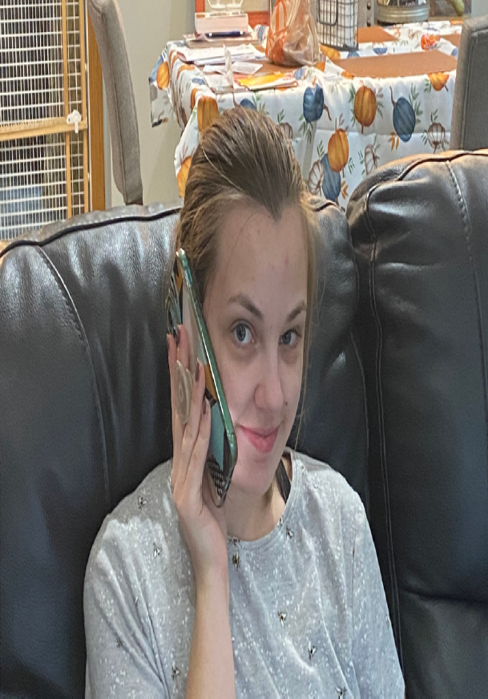
Day of Your Health Care Visit
Call ahead if you will need help getting in the building.
Bring your medication list and questions you want to ask.
Notes:
Read Slide
Make sure your support person knows how to support you at the doctor visit.

Slide 12
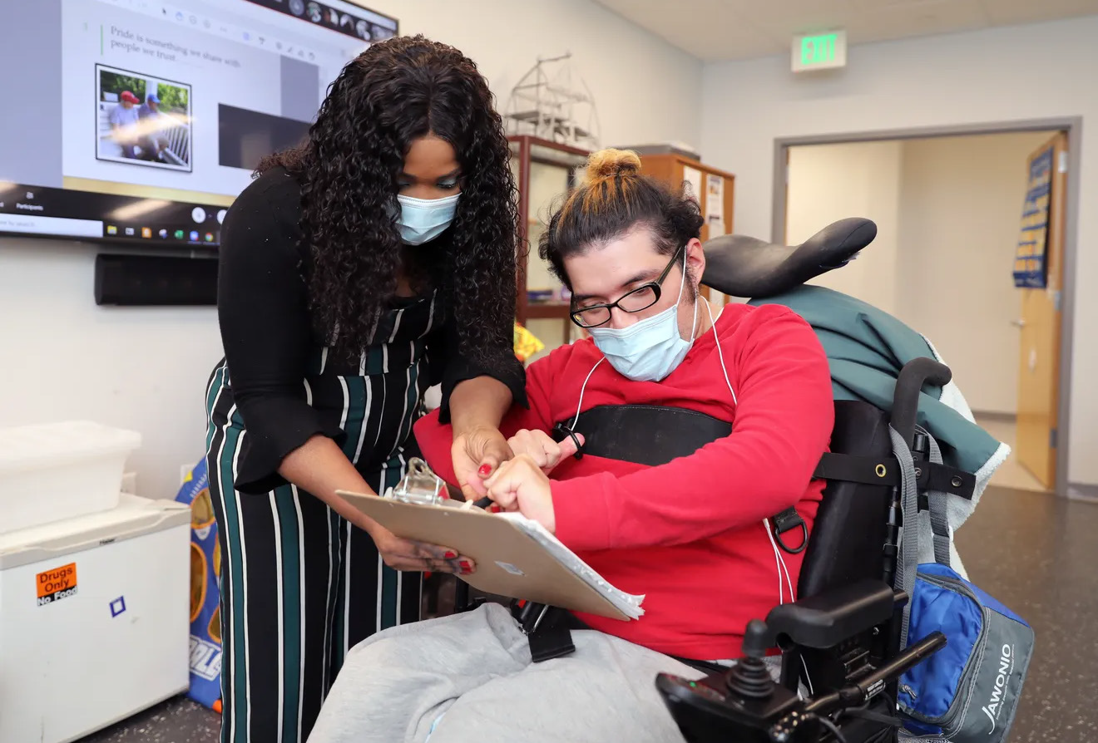
During Your Health Care Visit 1
Talk to the doctor about your health concerns or questions.
If there is something you don’t understand, ask the doctor to explain it again.
Notes:
Read Slide
It is important that the doctor, nurse, office staff, etc. speak to you directly. If you have someone there, be clear about how they are supporting you during the visit.

Slide 13
During Your Health Care Visit 2
Tell the doctor, nurse and others how to best support you.
Ask for materials in the format you need.
Notes:
You know yourself best.
Read Slide
We are going to work on a one-page description later in the training. This tool will help you share with all health care providers how best to support you.

Slide 14
How Best to Support You
Alternate or different formats include:
Large print materials
American Sign Language (ASL)
Braille
Plain language
Photos or picture format
Video or audio recording
Notes:
When you set up your doctor’s appointment, let them know of any accommodations you need. Some of those accommodations can be different forms of communication.
As a self-advocate, let everyone know how you communicate best. This could be reciprocal communication as well as reading information.

Slide 15
After the Health Care Visit 1
Get prescription medication filled (if needed).
Add follow up appointments to your calendar/schedule (if needed).
Notes:
Read Slide
As an adult, you can decide who you share medical information with.

Slide 16
After the Health Care Visit 2
Go over any notes with your supporter.
Ask them what they think went well and what could have been better.
Call the doctor’s office if you need more information or have questions.
Notes:
If you would like to share medication information, you can:
Read Slide

Slide 17
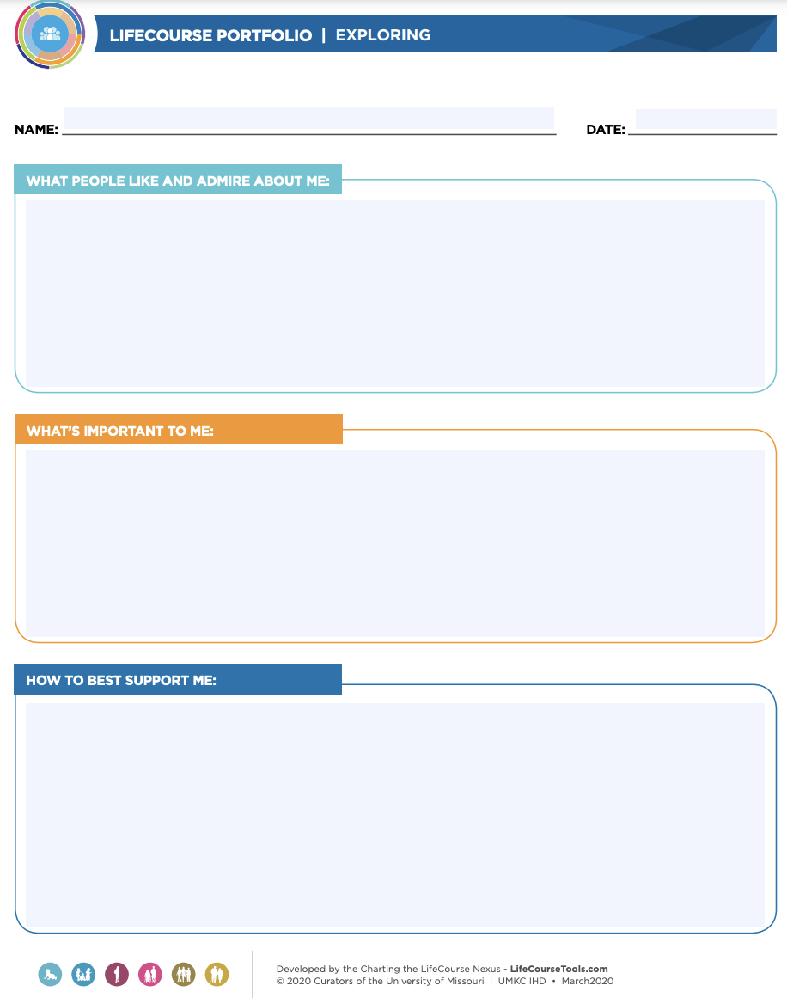
One-Page Description
A one-page description shares important information about a person on a single sheet of paper.
The description highlights three focus areas:
what people appreciate about me
what’s important to me
how best to support me
Notes:
The one-page description is a great tool to use when working with different doctors or health care providers. This is also a great tool for office staff as they will be working with you on scheduling appointments.
The one-page description shares information about you. How you need information shared with you or how you will need to share information. This can be a document that is shared if you are not able to communicate your accommodations clearly.
The participants can complete this in a small group or whole group to practice. Ideas can be shared, or you can discuss a scenario to have participants create a One-page description.
Read through each section and give ideas.
What people like and admire about me.
What is important to me.
How to best support me.

Slide 18
Resources
OSHU (Oregon Office on Disability and Health) Fact Sheet:
Supporting Self-Advocacy (for “supporters” – tips on fostering self-advocacy in medical settings)
https://www.ohsu.edu/sites/default/files/2022-08/FS_01.pdf
OSHU (Oregon Office on Disability and Health) Fact Sheet: Supporting Someone Who is Going to the Doctor (for “supporters” – tips on providing assistance with medical appointments)
https://www.ohsu.edu/sites/default/files/2022-08
NAMI – Medical Self-Advocacy
https://heartsandminds.nami.org/articles/medical-self-advocacy/
Notes:
These resources were used to create this training.
It is important to understand how to take the lead during health care visits.
This training goes along with the EZ Reader Leading Health Care Visits.
Thank you for joining us.

Slide 19
Resources Continued
Pacer Center: Building Self-Advocacy and Self-Care Management Skills
www.pacer.org/transition/learning-center/health/building-self-advocacy.asp
NCHPAD (National Center on Health, Physical Activity, and Disability) Video: How to Talk to Your Doctor
www.youtube.com/watch?v=v11FU_97L-g
How Do You Prepare for a Medical Appointment
www.youtube.com/watch?v=o2Hc2Rd5mRs&t=11s
One-Page Description
https://www.lifecoursetools.com/lifecourse-library/foundational-tools/person-centered/

Slide 20
Acknowledgments

