Slide 1
Learning About Adult Health Care
Notes:
We are going to learn more about Health Care as an adult.
We will refer to the EZ-Reader Learning About Adult Health Care throughout the training.
A learning activities will be completed in the training.
Please ask questions as we go through.

Slide 2
Learning Objectives
The participant will:
Recognize and share individual health care needs
Identify the different doctors, specialists, therapists and health care workers
Organize and share information about personal health care
Notes:
In the training today, we will talk about:
The importance of knowing and understanding your disability.
The differences between
Doctors
Specialists
Therapists
Health care workers
Making lists of medication and doctors to better understand and organize information about your adult healthcare.

Slide 3
You will soon be an adult and can take charge of your own health care.
Notes:
Read Slide
It is important to know how your disability affects your overall health and way of life.

Slide 4
Can you explain your disability and needs to others?
Notes:
Read Slide
Can you share your disability with someone who does not know you?
How can you get the information?
Possible answers:
Parents
Teachers
Siblings
If you do not know what your disability is, can you share some things you do different or need help with?
Facilitator Notes:
This slide is to get participants aware of how to express their needs.
Person with lived experience: Talk about how you share the information (notecard, verbally, AAC, etc.)

Slide 5
Do you know the names of the doctors and other health care workers you see?
Notes:
Read Slide
Do you know why you see each doctor or health care worker? What do they do?
Give example:
allergy doctor for my allergies
Ophthalmologist (eye doctor) for my glasses
Have participants share out as they feel comfortable.
Person with lived experience—can share 1-2 doctors they see
We are going to learn more about doctors, specialists, therapists and other Health care workers in this training.

Slide 6
Medicine can help you take care of your health
Notes:
Read Slide
Do you know the names of each medicine and why you take it? You may need to share this information with your doctors and others.

Slide 7
Medicines
Mackenzie
Create a list of medicines
What is the name of the medicine?
Why do you take it?
When do you take it
Notes:
It is important to keep a list of the medicines you take and why you take it.
Read Slide
Listen to Mackenzie explain how and why to have a list of medications.
We will see examples of how you can keep track of your medicines later in the training.

Slide 8
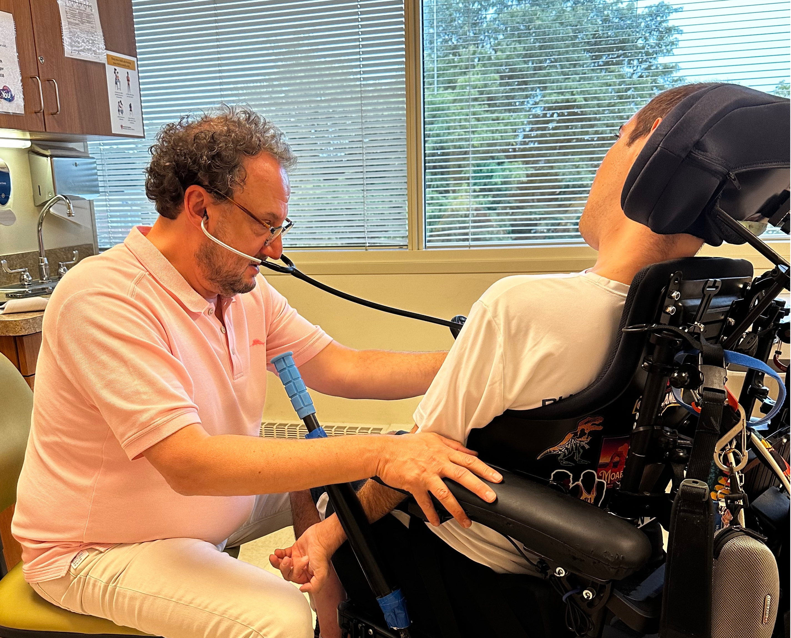
Different Kinds of Doctors
We see doctors to get and stay healthy.
Notes:
You may see doctors for different things.
You may have a cold, sore throat or pain in your stomach.
These doctors are often general doctors.
You may see a doctor for a broken foot, head injury or hearing problem.
These doctors are often specialty doctors.

Slide 9
Pediatrician
A pediatrician is a doctor who specializes in treating babies, children and teenagers.
Notes:
Read Slide
A pediatrician checks for health issues and can keep vaccinations up to date. A pediatrician can also track physical and mental developments.

Slide 10
Family Physician
A family physician is a doctor that provides health care to people of all ages.
A family physician is sometimes called a general practitioner.
Notes:
A family physician sees children and adults for regular checkups. A family physician treats many common things like the cold, flu, cough, sore throat or minor injuries, like a sprained ankle.

Slide 11
Internal Medicine
An internist or internal medicine doctor cares for adults.
Notes:
Read Slide
Internists may see older teens who will be adults soon. Internists provide the same kind of care that family physicians do.

Slide 12
What Is a Specialist?
A specialist can help with specific health issues.
Notes:
Another kind of doctor you may see is called a specialist.
Read Slide
A specialist can help you with specific health issues. Specialists are trained to know about one type of illness or part of the body.

Slide 13
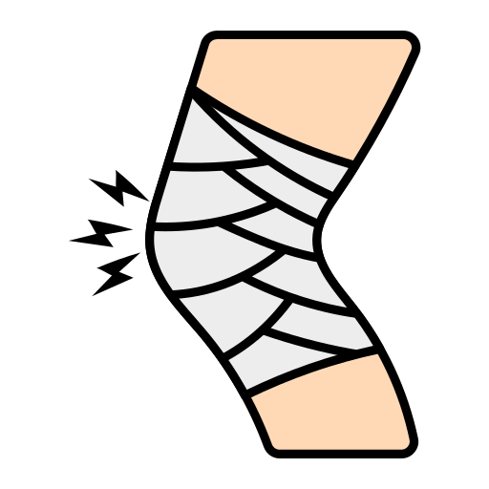
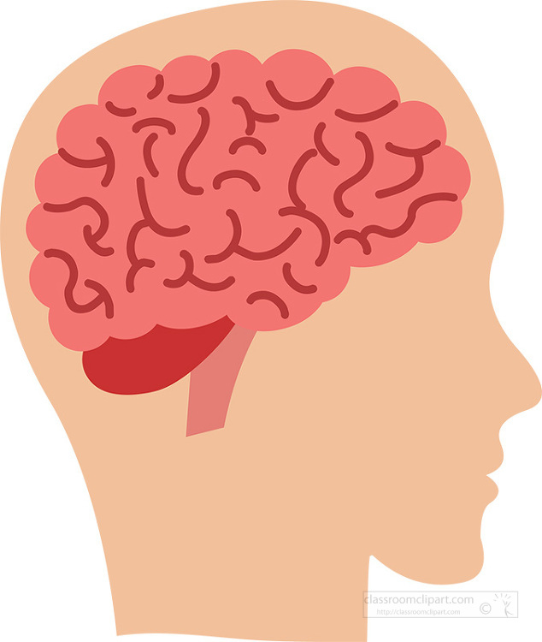
Types of Specialists 1
Orthopedic doctor—takes care of bones and muscles.
Neurologist—takes care of the brain and nervous system.
Oncologist—treats cancer and other growths.
Notes:
Read Slide
ASK:
If you broke your ankle, which doctor would you see?
When would you see an Oncologist?

Slide 14
Types of Specialists 2
Cardiologist—takes care of the heart.
Pulmonologist—takes care of the lungs and breathing.
Ophthalmologist—takes care of the eyes.
Notes:
Read Slide
Ask:
Which specialist would you see to get new glasses?
Give an example of when you would see a Cardiologist? (heart monitor)

Slide 15
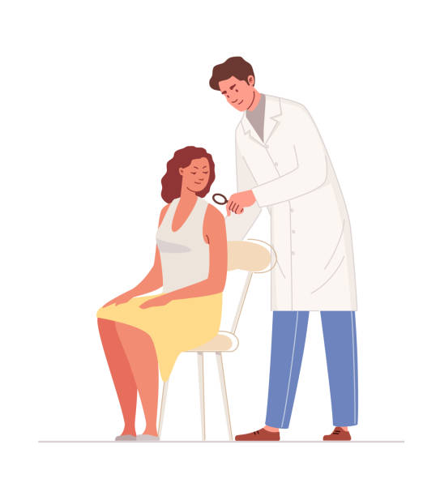
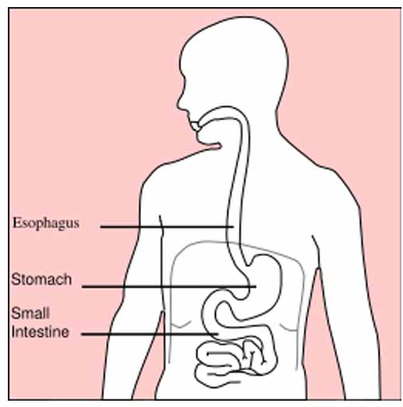
Types of Specialists
Dermatologist—takes care of the skin, hair and nails.
Endocrinologist—takes care of people who have diabetes or thyroid issues.
Gastroenterologist—treats stomach, bowel and colon issues.
Notes:
Read Slide
Ask:
Which specialist would you see if you have a mole on your arm?
Give an example of when you would you see a Gastroenterologist?

Slide 16
Surgeon
A Surgeon treats conditions that might need an operation.
Notes:
Another kind of specialist is a surgeon.
Read Slide
Some surgeons focus on just one body part or area of the body.

Slide 17
Reproductive Health
A Gynecologist is a doctor who checks on the reproductive health of women.
Some gynecologists are also obstetricians.
Obstetricians see pregnant women and deliver babies.
Notes:
Read slide
A gynecologist performs the pap-test and examines the uterus and ovaries in women.

Slide 18
Health Care Workers
Health Care Workers can be nurses, psychologists and therapists.
Notes:
There are many kinds of health care workers. It is important to know about the different kinds of health care workers.
Read Slide

Slide 19
Therapists
Physical Therapist—help improve movement or manage pain.
Occupational Therapist—help with daily living activities.
Speech Therapist—help to speak more clearly or to communicate better.
Notes:
Different therapists specialize in different areas.
Read Slide
These therapists help you interact with your school, community, home, etc.

Slide 20
Mental Health Specialists
A Psychiatrist is a medical doctor who treats mental, emotional and behavioral disorders. They can prescribe medication.
A Psychologist treats mental health issues but does not prescribe medication.
Notes:
Read slide
Both can help if you feel sad, anxious or angry.

Slide 21
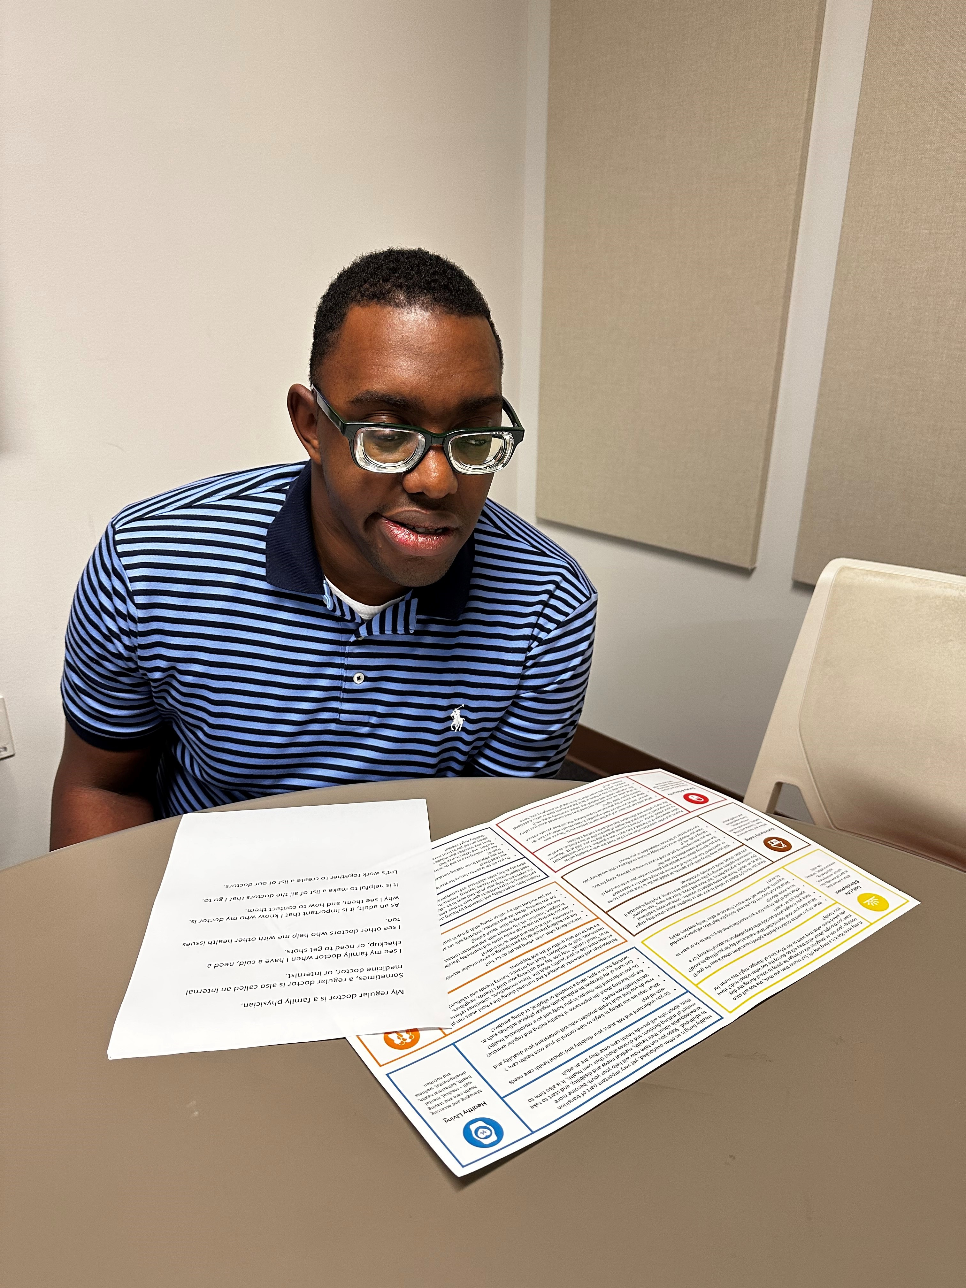
AJ
Notes:
As you transition into adult health care, it is important to know the doctors and specialists you see.
Listen to AJ share a list of doctors and health care workers.

Slide 22
Medical Provider List
The Healthy Living Medical Provider List is a tool to help you organize your doctors, specialist and health care workers, and how they support you.
Notes:
Read Slide
We will create a list of doctors and health care workers.
Learning Activity Healthy Living Medical Provider list – put participants in smaller groups or a big group to discuss how and why they would complete this tool.
Facilitator Notes:
The participants can review this tool and take it with them to complete on their own. It may be helpful to talk through the Medical Provider List and see if the participants know their doctors and how they support them.

Slide 23
Resources
Care Notebook, Utah Medical Home Portal
https://ut.medicalhomeportal.org/living-with-child/caring-for-children-with-special-health-care-needs/managing-and-coordinating-care/care-notebook#d74547622e189
National Institute of Health
https://www.nih.gov/
25 Types of Doctors & what they do for Patients’ Health - Good Housekeeping
https://www.goodhousekeeping.com/health/wellness/a33863644/types-of-doctors/
Notes:
These resources were used to create this training.
It is important to understand adult health care. Understanding the different medical providers, medicines and what doctor to see based on your needs.
This training goes along with the EZ-Reader Learning About Adult Health Care.
Thank you for joining us. ☺

Slide 24
Resources Continued
What are the Different Types of Doctors?
https://www.webmd.com/health-insurance/insurance-doctor-types
Types of Doctors – 20 Types of Specialists
https://www.youtube.com/watch?v=SwOph2acW7M
SKOOLL – Which Doctor Treats What Disease?
https://www.youtube.com/watch?v=Ku_iqEElWlA
Charting the LifeCourse Healthy Living Tools (Medication and Doctor’s tool)
https://www.lifecoursetools.com/lifecourse-library/exploring-the-life-domains/healthy-living/

Slide 25
Acknowledgments

