Slide 1
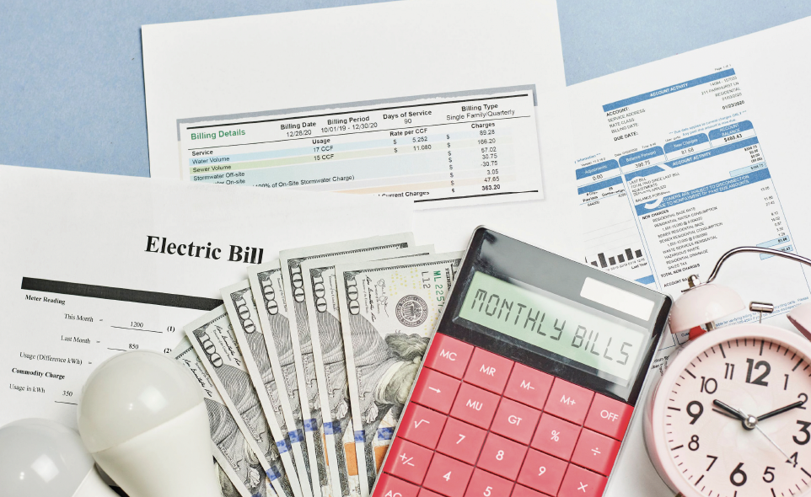
Making a Budget
Notes:
Refer to the EZ-Reader Making a Budget throughout the training.
This training will discuss what is a budget and how you create a budget.
A learning activity will be at the end of the training.
Please ask questions as we go through.

Slide 2
Learning Objectives
The participants will:
Identify the different types of expenses included in a budget
Describe the steps in developing a budget
Modify a budget to reflect changes in expenses
Notes:
Creating and sticking to a budget. What does that mean?
In the training today, we will talk about:
The different types of expenses included in a budget
The steps in developing a budget
How to modify your budget to reflect changes in expenses

Slide 3
I have income coming in and expenses going out. How do I manage my money?
Notes:
You have learned about income and expenses. Now let’s talk about how to manage your money.
Creating a budget helps you pay your bills on time, be prepared for emergencies, and reach your financial goals.

Slide 4
What Is a Budget?
A budget is a plan for spending and saving money.
A budget helps you know how much money you make and how much you can spend.
Notes:
A budget is a way to balance the money coming in and the money going out.

Slide 5
How Do I Earn Money?
You can receive income in a variety of ways.
A job
Gifts
Trusts
Government benefits
Notes:
Read Slide
To make a budget, you need to know how much money you are earning. You need to make sure you have enough money to pay your bills and other expenses. You want more money coming in than going out.
Briefly review trainings 1 and 2 on income and expenses.
Facilitator Notes: Review training 1 on income and expenses if this is the same group of participants.
Training 1—Income is money you receive when working, as a gift or a benefit.
Training 2—Expenses are things you pay for.

Slide 6
What Are My Expenses?
Rent
Food
Utilities
Entertainment
Notes:
Now that you have identified how much money you earn (or your income), you need to review what you spend (or the types of expenses).
Read Slide

Slide 7
Reasons to Budget
A budget helps you decide how to spend your money and save your money.
Notes:
A budget can help you make decisions about money.
A budget can help you save money for the future or for emergencies.
A budget can help you decide what you can and cannot afford.
A budget can show you what expenses you must pay and what money you have left.

Slide 8
How to Get Started
Decide the amount of time you want to budget.
One month
Six months
A year
Notes:
Read Slide

Slide 9
Add Up Your Income
Make a list and add up all the ways you get money for the month.
Multiply that amount by the number of months in your budget.
Ex. 1 month income = $1,000 x 12 months (year) = $12,000 in a year
Notes:
After you make a list of all your income, you will multiply that by how many months in your budget.
The example shows total income of $1,000 a month, multiplied by 12 months to get a total of $12,000 in a year to budget for.
Or you can create a budget for 1 month and know that you have $1,000 to budget for.

Slide 10
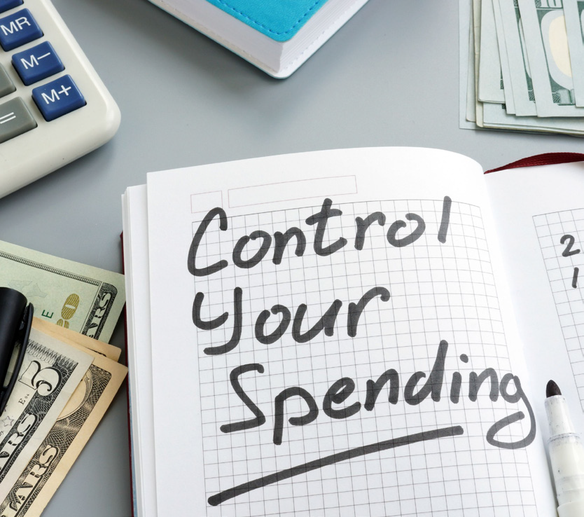
Set Guidelines
Set guidelines on how much money should go to different expenses.
Notes:
If you choose to spend more money on some expenses, remember to reduce other costs accordingly.

Slide 11
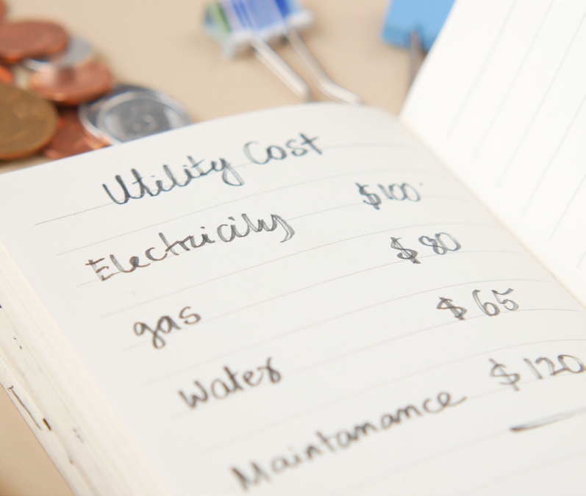
Estimate Expenses
Make a list of bills that stay the same amount each month (fixed).
Rent
Car payment
Make a list of bills that are different each month (varied).
Water bill
Electricity bill
Notes:
Remind participants about the earlier training on expenses – fixed and varied.
When listing your expenses/bills, you may want to estimate or take the average amount of bills that are different.

Slide 12
More Expenses
Make a list of how much money you spend on expenses like:
Food
Clothing
Personal care items
What about extras like:
Eating out
Video games
Notes:
Discuss needs and wants.
When talking about fixed and varied expenses, discuss needs and wants.
A need may be a coat to keep warm. A want may be A NorthFace coat. A name brand item may not be affordable at this time.
Facilitator Notes: Discuss types of expenses. Get information from participants.
ASK: How much money do you spend on food? Personal care items?

Slide 13
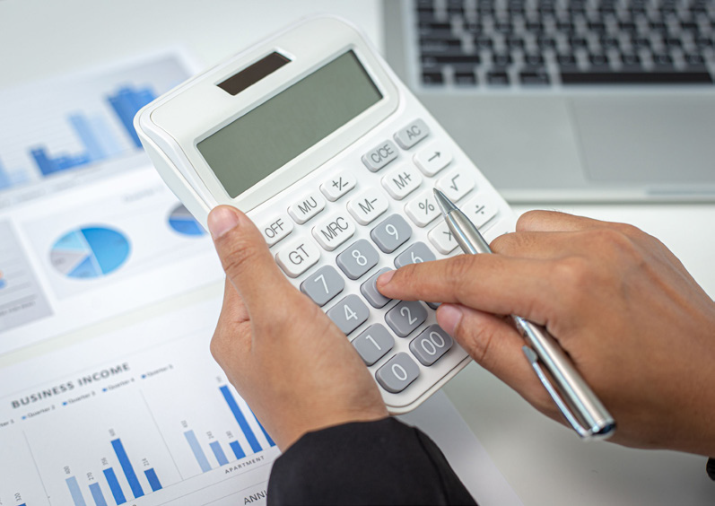
Balancing Income and Expenses
Add up your income
Add up your expenses
Subtract your expenses from your income.
Ex. $1,000 - $800 = $200 left
Notes:
The goal is to have some money left after you subtract your expenses. If you have more expenses than income, you must reduce your expenses.
An example may be to reduce going out to eat and make meals at home. You can also reduce the items that are considered “wants:”
Ugg boots
Sports team jersey
Play Station game

Slide 14
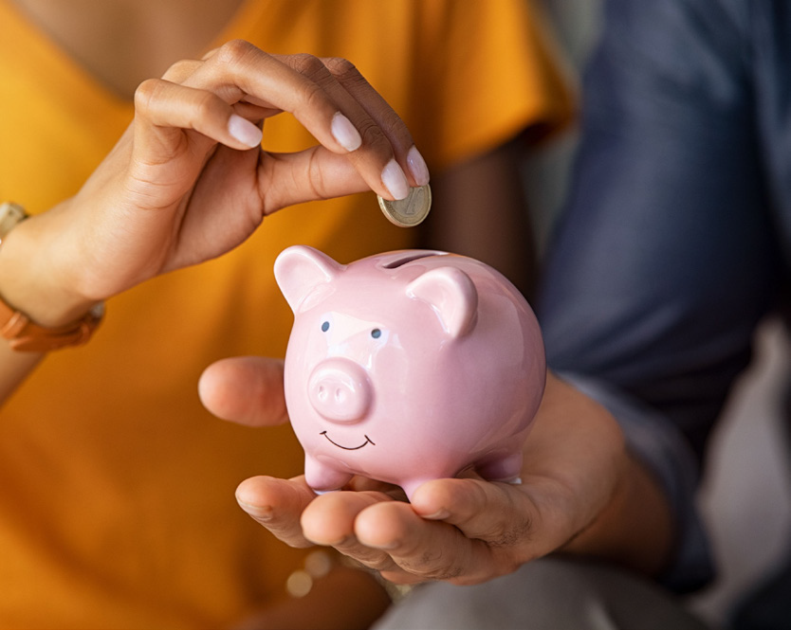
Extra Money
You could spend extra money on:
going to the movies
eating out
You could also put some extra money away or save it.
Saving extra money will allow you to buy something you want or need in the future.
Notes:
When you have money left at the end of the month, you can decide what to do with it.
Read Slide

Slide 15
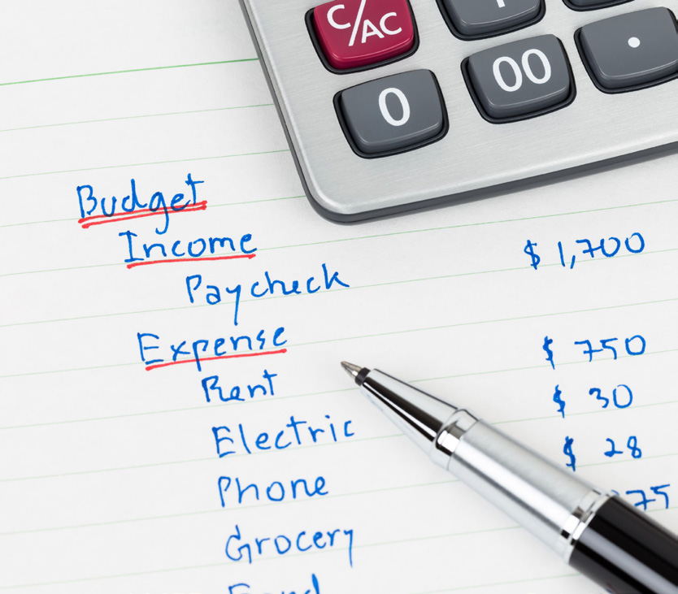
Check Budget
Check your budget each month to see how you are doing.
You can adjust your budget as you see how much you are spending.
Financial Calculator
https://www.practicalmoneyskills.com/en/resources/financial-calculators/budget-goals/rework-budget.html
Notes:
After creating your budget, review it monthly. You want to see if your guesses on how much you spend are correct. You may be surprised to see what you spend on “unnecessary” expenses.
Adjust your budget to fit your financial goals. This online Financial Calculator can help you budget.
Facilitator Notes: Click on the online Financial Calculator for Budgeting. Take a minute to review the online calculator for participants to review later.
Financial Calculator
https://www.practicalmoneyskills.com/en/resources/financial-calculators/budget-goals/rework-budget.html

Slide 16
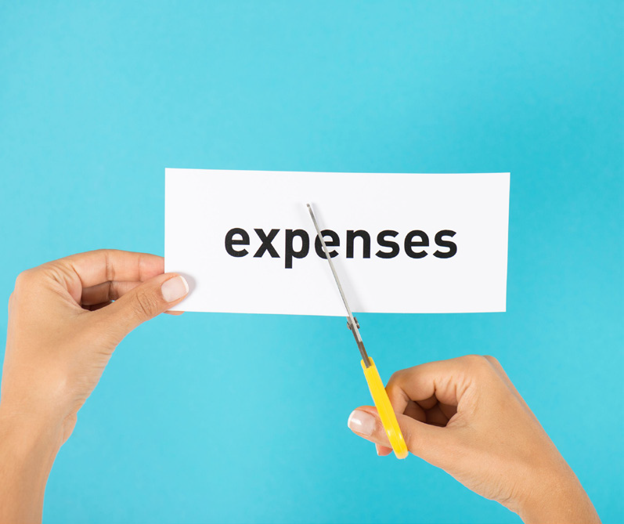
Making Changes
If you have more expenses than income, there are things you can do.
Cut back on expenses
Find a way to make more money each month
Notes:
Read Slide

Slide 17
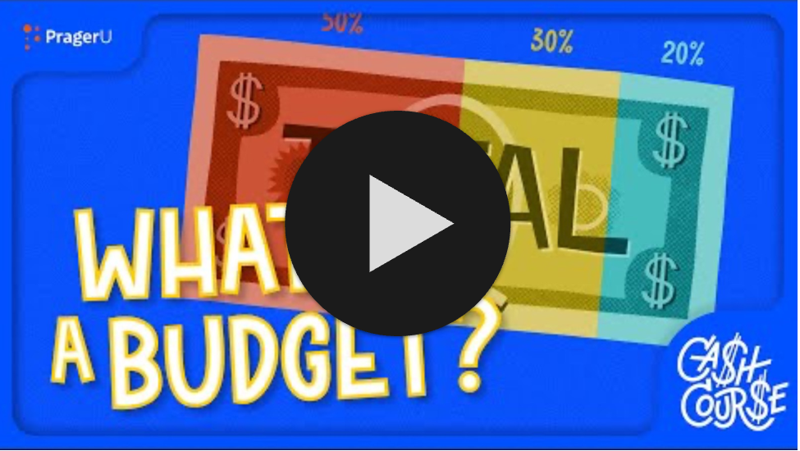
What is a Budget: Video
Ctrl + Click on the image to watch the video on YouTube!
Notes:
This is a video about Budgeting.
https://www.youtube.com/watch?v=CbhjhWleKGE
What is a Budget? (4:45 length)

Slide 18
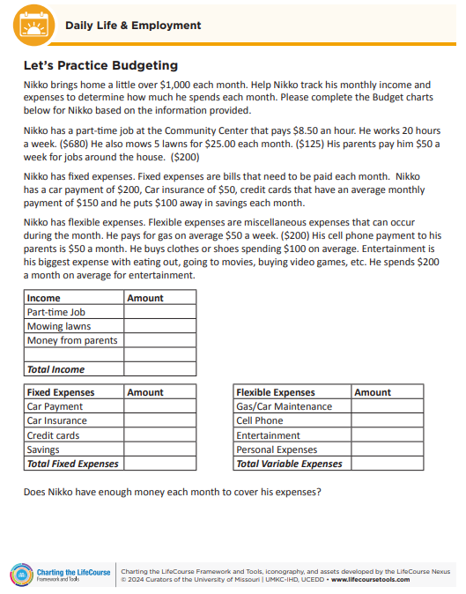
Let’s Practice Budgeting
Let’s practice working with a budget.
Notes:
Read Slide and refer to the worksheet to complete.
Put the participants in groups to complete worksheet.
Read through the scenario, complete the budget and answer the question, “Does Nikko have enough money each month to cover his expenses?”
Give the groups 10 minutes to complete the activity.
Pull the group back together to share out what their group determined.

Slide 19
Resources
PragerU, What is a Budget? Video
https://www.youtube.com/watch?v=CbhjhWleKGE
Pacer Center – Making a Spending Plan
https://www.pacer.org/publications/possibilities/make-a-spending-plan/make-a-spending-plan.asp
Practical Money Guides: Budgeting Basics
https://www.practicalmoneyskills.com/en/resources/free_materials/practica_money_guide-money_basics.html
Financial Calculator
https://www.practicalmoneyskills.com/en/resources/financial-calculators/budget-goals/rework-budget.html
Notes:
These resources were used to create this training.
It is important to understand how to budget your money. Understanding what money you bring in and what money you pay out.
This training goes along with the EZ-Reader Making a Budget.
Thank you for joining us.

Slide 20
Acknowledgements: Community Life Guide: A Project of Ohio Department of Developmental Disabilities. Developed by Altarum and Life Course Nexus Training and Technical Assistance Center, UMKC institutes for Human Development, UCEDD

