Slide 1
Staying Safe Online
Notes:
Refer to the EZ-Reader Staying Safe Online throughout the training.
This training will discuss how to keep your personal information and money safe online.
A learning activity will be at the end of the training.
Please ask questions as we go through.

Slide 2
Learning Objectives
The participants will:
Identify what can put you at risk online
Describe ways to protect yourself online
Summarize the need for social media security
Notes:
Upon completion of this training, the participants will be able to:
Identify what can put you at risk online
Describe ways to protect yourself online
Summarize the need for social media security

Slide 3
The internet allows you to do many things while online.
Notes:
Read Slide
You can:
Shop
Play games
Bank
Stay in touch with family and friends

Slide 4
Being online comes with some risk.
Notes:
Read Slide

Slide 5
Stay Safe Online
When online, there are:
Things that can put you at risk
Ways to protect yourself
Notes:
What can you do to stay safe online?

Slide 6
DO NOT share your personal information:
Your name
Your phone number
You address
Your banking information
Your Social Security Number
Notes:
Read Slide
Sharing your personal information online can place you in an unsafe situation. You cannot be sure you are speaking to someone you trust. It is always best to NOT share any personal information with strangers. Later in the training we will discuss shopping online and secure websites.

Slide 7
DO NOT share your daily schedule:
Appointments
Trips
Work
Notes:
Read Slide
You should not share your daily schedule online. Only family and close friends should know personal information about you.

Slide 8
DO NOT share your current location.
Notes:
Read Slide
Only family and trusted friends should be able to locate you.

Slide 9
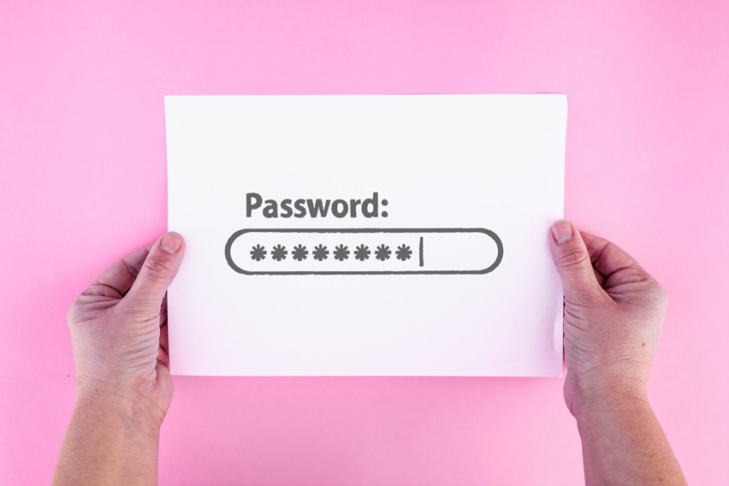
A strong password is one of the best ways to keep your online accounts safe.
Notes:
You may have a variety of online accounts (i.e., social media accounts, bank account, etc.). Passwords work to keep your information safe with this online account.

Slide 10
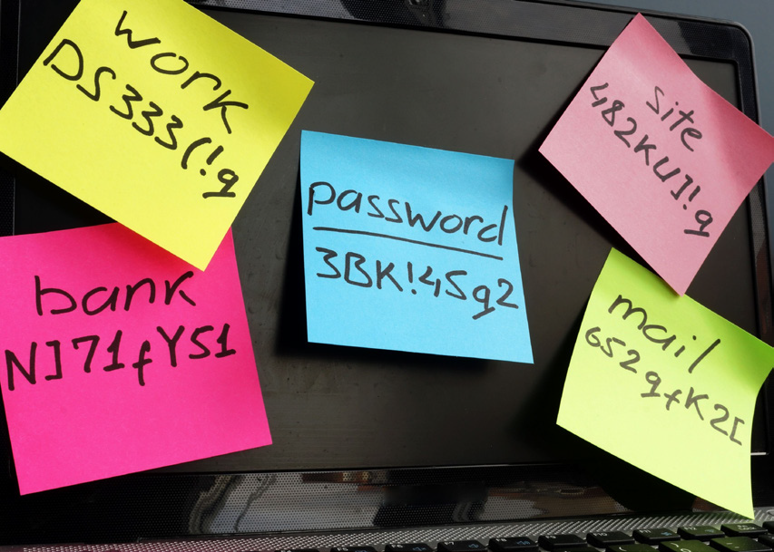
A strong password should include:
UPPERCASE letters
lowercase letters
Numbers
Symbols (%#&*)
Notes:
Read Slide
Keep your passwords in a safe location that you can easily locate. Talk with family and friends about suggestions on where to keep passwords.

Slide 11
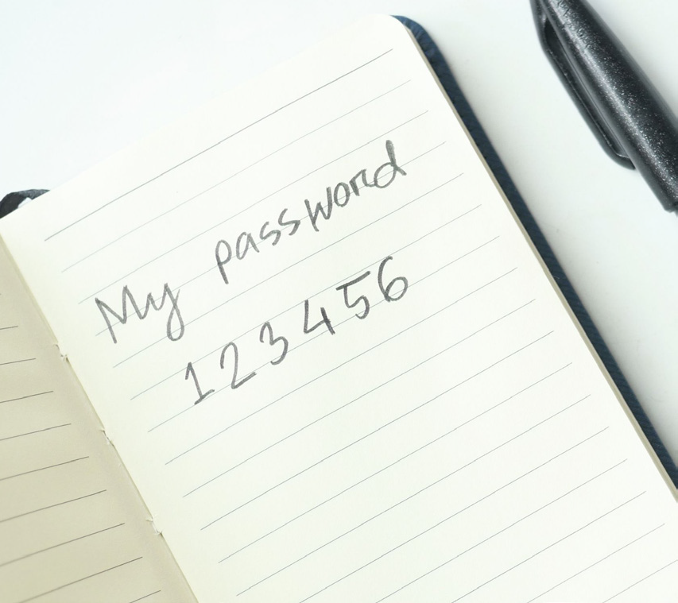
A strong password should NOT include anything that would be easy to guess:
Dates (birthdates, anniversaries)
Numbers in a row (123456)
Notes:
Read Slide

Slide 12
Forgot Your Password
Recovery or security questions can help if you get locked out of your account or forget your password.
Notes:
Read slide
Recovery or security questions should be questions only you can answer.
These questions will confirm your identity and unlock your account.

Slide 13
What is Online Banking?
Notes:
Read Slide

Slide 14
Online Banking
You can:
See how much money you have in your accounts
Track your spending
Transfer money between your accounts
Deposit checks
Notes:
Online banking is an easy way to handle your finances without going to a bank.
Read slide

Slide 15
Keep Your Banking Details Private
Do Not Share:
Where you bank
Your account numbers
Your online banking password
How much money you have in your bank account
Notes:
Read Slide

Slide 16
Online Banking Safety
Do not log onto online banking from a device you don’t trust.
Notes:
Read Slide
This could be a device that is public (computer in a library) or a shared computer (computer in school).

Slide 17
Online Banking Safety part 1
Do not enter your banking details into websites you do not know.
Notes:
Read Slide

Slide 18
Online Banking Safety part 2
Ask a close family member or friend for help if you are unsure about a website.
Notes:
Read Slide

Slide 19
How to Avoid Scams
Notes:
Being safe online is being aware of scams and scammers trying to steal your identity or money.

Slide 20
Scammers
Scammers try to. . .
trick you into giving information about money.
pretend to be a person you trust or an organization you know,
ask you to send them gift cards as payment.
Notes:
Read Slide
Remember—real organizations will never ask you for gift cards.
Never give out personal information to someone you do not know on the phone.
Let the call go to voicemail if you do not recognize the number and are not expecting a call. You can listen to the voicemail later and determine if you need to follow up.

Slide 21
Email Scams part one
You should always check the email address of the person emailing you, especially if they want information or money.
Notes:
Read Slide
Watch for strange spelling or word choices in emails. This may mean the email is a scam.

Slide 22
Email Scams part two
Be careful when clicking links or pictures in an email.
Notes:
Read Slide
Scammers can use those links to steal information from your computer or phone.
An email from an organization may ask you to call them using the number listed in the email. Instead, look up the number on the organization’s website.

Slide 23
Emails and Your Bank
If you receive an email from someone claiming to be from your bank, call your bank to make sure the email came from the bank.
Notes:
Read Slide
Your bank’s phone number is often on the back or your debit or credit card or on the bank’s website. Always call the bank if you are unsure about anything. It is best to be safe and check.

Slide 24
Phone Scams
Scammers sometimes call and claim to be someone you know or from an organization. Never give out personal information to someone you do not know on the phone. Let the call go to voicemail if you do not recognize the number and are not expecting a call.
Notes:
Read Slide
ex. Saying you won a prize

Slide 25
Calls and Your Bank
If you receive a call from someone claiming to be from your bank, get their name, hang up and call your bank back to make sure that person works at the bank.
Notes:
Read Slide
Just like with an email that looks like it might be from your bank. Get the name of the caller, hang up and call your bank. It is always best to be safe.

Slide 26
Text Scams
Scammers also send fake text messages to trick you into giving your personal information. Often scammers will send a link that might take you to a fake website or install a virus on your phone.
Notes:
Read Slide
Ex. Send a fake package delivery notification
Never click on a link from a number you do not know. If you think a text is a scam, you can report it as spam in your text messaging app.

Slide 27
Social Media Security
Notes:
Let’s talk about social media and security.

Slide 28
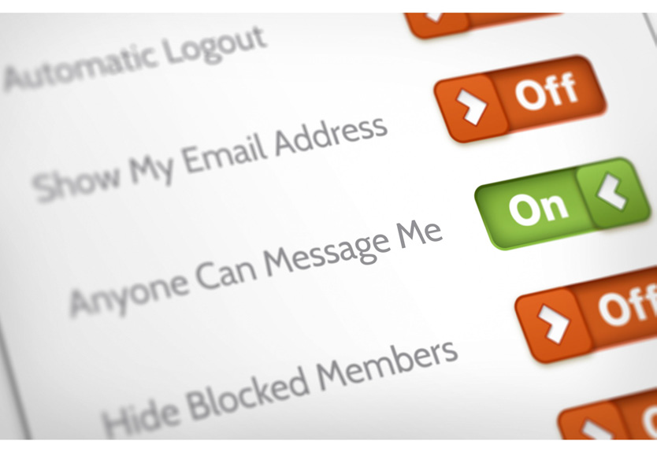
Social Media Security part 1
Give the minimum amount of personal information when setting up a social media account online.
Notes:
Read Slide
Use strict privacy settings for your social media account.
Choose privacy settings that limit who can see or respond to your posts.

Slide 29
Social Media Security part 2
Do not comment on posts that ask for personal information:
Your mother’s maiden name
Your birthday
Your first pet
Where you went to school
Where you were born
Notes:
Read Slide

Slide 30
Social Media Security part 3
An example is a post that says:
“What is your mother’s maiden name + your first pet’s name = your Superhero’s name!”
Notes:
Read Slide
Scammers can get information that may be used as passwords.

Slide 31
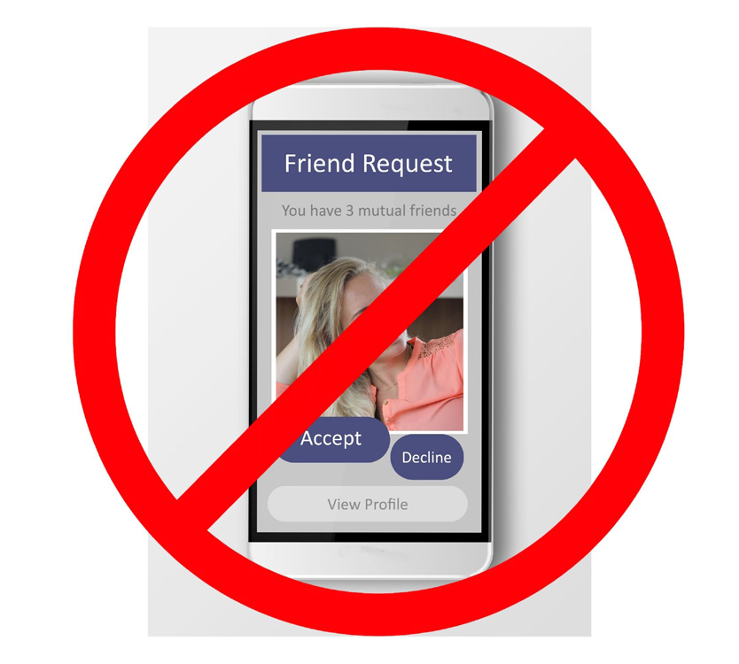
Social Media Security part 4
When a friends gets “hacked,” the scammer sends fake requests or messages.
Notes:
Read Slide
It looks like it is a message from your friend, but it is really a trick.

Slide 32
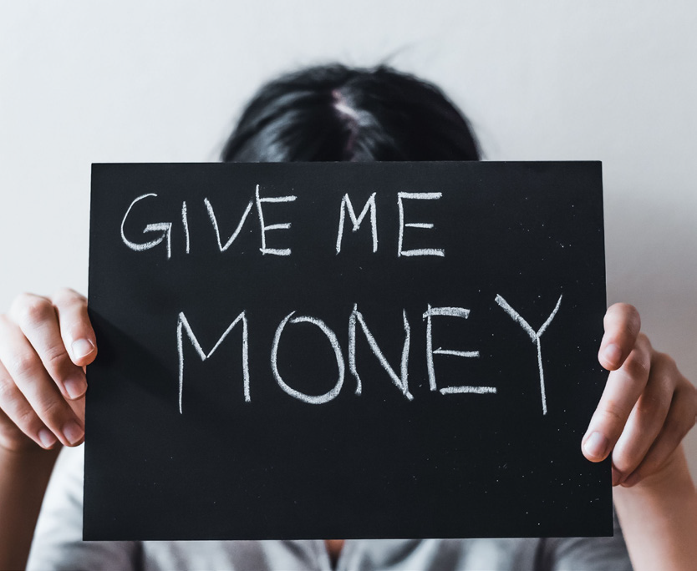
Social Media Security part 5
Be careful when. . .
a friend messages you asking for money or gift cards (likely a scam).
a friends sends you a random link (don’t click on it).
Notes:
Read Slide

Slide 33
What Does It Mean to Get Hacked?
Notes:
Read Slide

Slide 34
A hacker is someone that gets into your social media account without your permission.
Notes:
Read Slide
The hacker can take over your account and pretend to be you.
The hacker might be able to get to other information on your computer or phone.

Slide 35
What To Do If Your Social Media Is Hacked?
Reset your password
Make a post letting friends know not to click on any links from you
Make sure your bank and other accounts are secure
Report you were hacked to the social media app
Notes:
Read Slide

Slide 36
What To Do If Your Social Media Is Hacked? continued
Ask for help to make sure your accounts are secure
Do not add people on social media if you do not know them
Do not click on or play any games that ask you to share personal information
Use privacy setting on social media apps
Notes:
Read Slide

Slide 37
What To Do If You Think You Have Been Scammed
Do not talk with the scammer anymore.
Change passwords on the account that has been affected.
Call your bank or credit card company if the scammer has access to your account.
Notes:
Read Slide

Slide 38
Online Shopping
Make sure the business you are buying from has a good reputation and a professional website.
Use a secure payment method.
Credit cards and online payment systems (PayPal) are safest.
Notes:
Read Slide

Slide 39
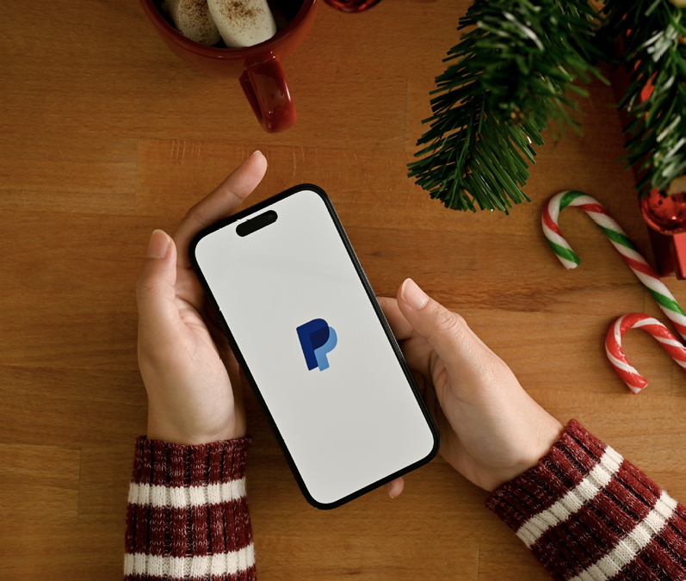
Online apps
Transportation apps:
Uber
Lyft
Payment apps:
Venmo
PayPal
Notes:
Read title
Payment apps connect to payment information and are used to make purchases online or send money to others.
Some of these apps will keep your card and bank information when you set up an account.
It is very important to make sure you know which ones you use and use a good password.

Slide 40
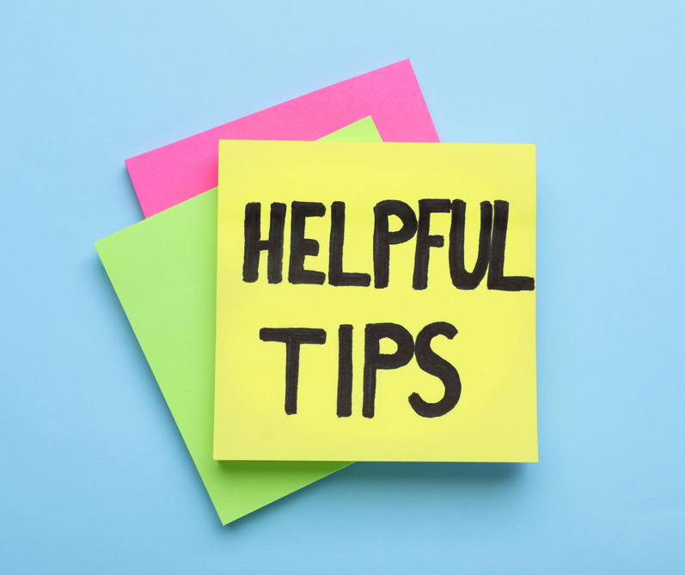
Tips and Reminders for Staying Safe Online
Do not share your passwords.
Do not post private information.
Do not add people to your social
Do know who your online friends are.
Do use privacy and security settings.
Do use a secure payment system.
Do ask a family member or trusted friend for help if you are unsure.
Notes:
Read Slide

Slide 41
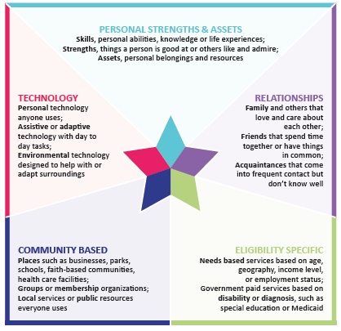
Integrated Supports Star
Notes:
The Integrated Support Star looks at 5 areas and what support you may need in all.
Strengths: What are our own strengths or skills or assets? What can we use, learn, etc to build capacity or support our needs?
Relationships: Who are the people in our lives? Who could help with one small thing?
Technology: Who doesn’t use technology these days? Technology can be high tech or low tech.
Community Supports: Where are places, groups or resources in the community you use or have access to?
Eligibility Supports: What (if any) supports do you receive? How can they help you transition to adult health care?

Slide 42
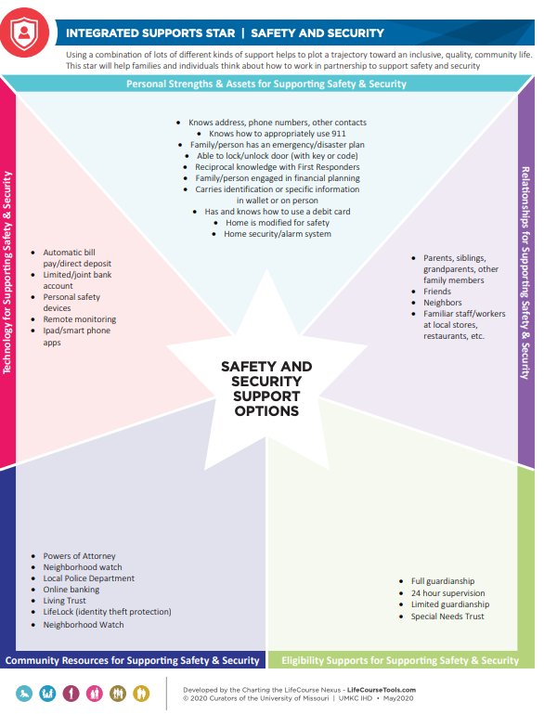
Integrated Support Star Example
Notes:
Here is an example of supports around safety and security.
Read through examples in each section.

Slide 43
Integrated Support Star
This is a tool that can help you plan or brainstorm ways you can get support when online.
Discuss with your group how each area of the Star can provide support with Staying Safe Online.
Notes:
Read Slide
Refer to the Integrated Support Star tool. Put the participants in groups to problem solve how each area of the Star can provide support with Staying Safe Online.
Give the groups 10 minutes to complete the activity.
Pull the group back together to share out what their group determined.

Slide 44
Resources
My Technology Handbook
www.sabeusa.org/wp-content/uploads/2019/05/My-Technology-Handbook-2.pdf
Practice Money Guide: Identify Theft
https://www.practicalmoneyskills.com/en/resources/free_materials/practical_money_guide-identity_theft.html
11 Internet Safety Tips for Your Online Security
www.youtube.com/watch?v=aO858HyFbKI
5 Tips to Stay Safe Online
https://netsafe.org.nz/wp-content/uploads/2022/04/5-tips-to-keep-safe-online-accessible-R.pdf
Notes:
These resources were used to create this training.
It is important to understand how to stay safe online.
This training goes along with the EZ-Reader Staying Safe Online.
Thank you for joining us.

Slide 45
Acknowledgements: Community Life Guide: A Project of Ohio Department of Developmental Disabilities. Developed by Altarum and Life Course Nexus Training and Technical Assistance Center, UMKC institutes for Human Development, UCEDD

