Slide 1
Planning for Adult Health Care
Notes:
We are going to learn more about Planning for Health Care as an adult.
We will refer to the EZ-Reader Making the Move to Adult Health Care throughout the training.
A learning activity will be completed in the training.
Please ask questions as we go through.

Slide 2
Learning Objectives
The participant will:
Demonstrate ways to choose a new doctor
Describe how to prepare for a new doctor
Identify the level of support needed for a new doctor
Notes:
In the training today, we will talk about multiple ways to choose a new doctor as well as preparing yourself for the first visit.
Demonstrate ways to choose a new doctor
Describe how to prepare for a new doctor
Identify the level of support needed for a new doctor.

Slide 3
When Is It Time to Move to Adult Health Care?
Your parents or doctor may say you are old enough to see a doctor that treats adults.
You may feel that it is time for you to move to adult health care.
Notes:
There are many ways you will know it is time to move to adult health care.

Slide 4
Making the Move to Adult Health Care
You may have already started managing more of your own health care.
Notes:
You have been learning more about your own health and health care. Your health care will be different as you become an adult.
Read Slide

Slide 5
What Do You Want in a Doctor?
Do you prefer a male or female doctor?
Would you like a doctor in a small or a large practice?
Notes:
When choosing an adult doctor, ask yourself what you would like.
Read Slide

Slide 6
What to Think About When Choosing an Adult Doctor 1
Is the doctor’s office near you?
Is the doctor’s office easy to get to?
Does the doctor have more than one location?
Notes:
Read Slide

Slide 7
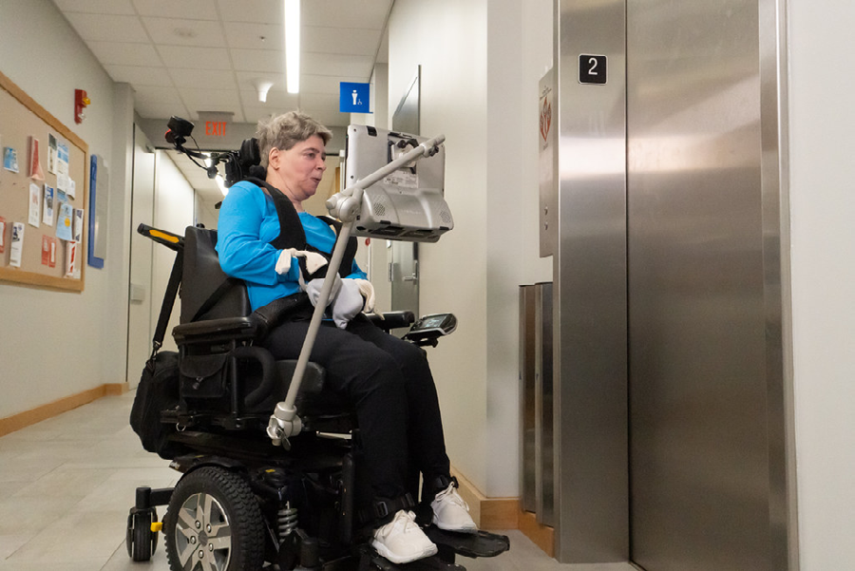
What to Think About When Choosing an Adult Doctor 2
How will you get to appointments?
Is the parking lot accessible?
Is the building easy to get into and get around inside?
Notes:
Read Slide
What is important to you?

Slide 8
Where Can You Find Doctors?
Start with the doctor you see now.
Ask for a list of adult doctors you could see.
Notes:
Ask your current doctor if there is a doctor they think would be a good fit for you.

Slide 9
Ask People You Know and Trust
Ask family members and friends about which doctors they see.
Notes:
Ask family members and friends if they have a doctor they think would be a good fit for you.

Slide 10
Check with Your Health Insurance
Health insurance companies have a list of doctors who are “in-network.”
In-network means your insurance will pay for part of the doctor’s visit.
Notes:
Read Slide
You may need to pay money called a co-pay to see a doctor.

Slide 11
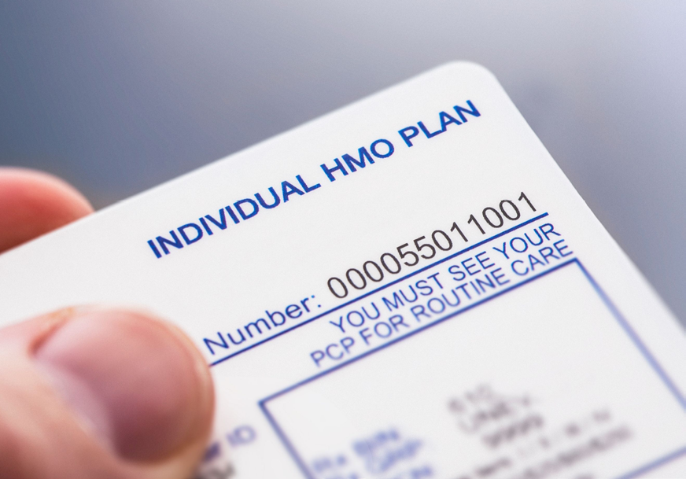
Things to Ask the New Doctor’s Office
Is the doctor taking new patients?
Does the doctor take your insurance?
What is the wait time to see the doctor?
Notes:
There are many questions you should ask and think about as you are choosing a new doctor.
Read Slide

Slide 12
More Things to Ask
When is the office open?
How quickly can you see the doctor if you are sick?
What if you get sick after hours?
Notes:
Read Slide

Slide 13
Contacting Your New Doctor
Ask how you should contact your doctor (by text, phone or email).
Ask how you would make, change or cancel an appointment.
Write down any contact numbers or emails they give you.
Notes:
Read Slide
These are great questions to ask when contacting a new doctor’s office. The receptionist or nurse can answer many of these questions.

Slide 14
Questions About Care
Will you always see the same doctor? Or are other health care workers available (nurse practitioner or physician's assistant)?
Are labs and x-rays done in the doctor’s office or somewhere else?
Notes:
Read Slide

Slide 15
Hospital Care
What hospital would the doctor send you to?
Is the hospital covered by your insurance?
Notes:
It is important to think beyond the doctor. What if you need to go to the hospital?
Read Slide

Slide 16
What Will You Pay?
What will you pay the for the visit?
What will happen if you cancel or miss a visit.
Notes:
It is important to understand what your insurance pays and what you will need to pay.
Read Slide

Slide 17
Getting Ready for Your New Doctor
Ask your current doctor to send a medical summary to your new doctor.
Notes:
Read Slide
A medical summary includes your history, treatments, and other things your new doctor should know about you.
It is important for your new doctor to have all your information before your first visit.

Slide 18
Before the Visit
Make a list of questions you want to ask your new doctor.
Plan to arrive 10 or 15 minutes early for your appointment.
Notes:
Read Slide
Have important documents like your ID and insurance card available.
Set a reminder on your phone or ask someone to remind you so you don’t forget appointments.

Slide 19
Before the First Visit
Call the doctor’s office to check on your medical information.
Plan how to get to the appointment.
Notes:
Call the doctor’s office to check on your medical information sent by your previous doctor. If it has not been sent, call you previous doctor to remind them to send the information.
Plan how to get to the appointment. ( i.e., friend, family member, Uber, etc.)
Let your doctor’s office know ahead of time if you cannot keep an appointment.

Slide 20
During the Visit
Ask your doctor questions from your list.
Take notes on what happens at the appointment.
Notes:
Read Slide
If you brought someone to support you, ask them to take notes if it would help you.

Slide 21
Important Things to Remember
Tell your doctor about your health history.
Tell the doctor about your symptoms if you are sick.
Notes:
Read Slide
This will help the doctor treat you the best way.

Slide 22
Your Responsibilities
Ask questions about your care.
Follow treatment plans that you and your doctor decide.
Let your doctor know if you are unhappy with your care.
Notes:
Read Slide
It is very important to let your doctor know if you are unhappy with how things are going. Be open and honest to try and resolve the problem.
Remember, it is your right to have good health care.

Slide 23
Ian S.
Notes:
Ian will share more about transitioning to adult health care.

Slide 24
Today, you learned about finding a new doctor and how to communicate your adult health care needs.
Today, you learned about finding a new doctor and how to communicate your adult health care needs.
Notes:
Read Slide

Slide 25
Today’s Health Care Visit
You have learned about what to do when transitioning to an adult health care provider.
The adult doctor you decide on will need to learn about you and your health care needs.
Notes:
Living a healthy life and keeping your body in good working order can take some planning and effort.
Healthy Living LifeCourse tools will help you have the conversations, explore your vision, and plan experiences and supports to achieve your healthy life.
The Learning Activity will explore Today’s Health Care Visit tool. This tool will help you keep track of everything you want to share or ask about during your health care visit.
Facilitator Notes:
The participants can review this now and take it with them to complete on their own. You can split them into groups to review the tool or discuss the tool as a group.
It may be helpful to read through the sections and discuss what they (or their support person) could write.

Slide 26
Resources
Got Transition – Sample Medical Summary
https://www.gottransition.org/6ce/?leaving-medical-summary-emergency-plan
YouTube – How Hunter found his adult doctor
https://www.youtube.com/watch?v=SjXIfyvqJhA
Got Transition – Questions to Ask Your Doctor
https://gottransition.org/resource/?hct-questions-ask-doctor-youth
Notes:
These resources were used to create this training.
It is important to understand how to plan for adult health care. Understanding what you need to do when looking for a new doctor is important.
This training goes along with the EZ Reader Making the Move to Adult Health Care.
Thank you for joining us.

Slide 27
Resources Continued
Got Transition – One page information sheet
Information about a Joint Telehealth Visit for Young Adults
Medline Plus – Choosing a Primary Care Provider
https://medlineplus.gov/ency/article/001939.htm
Today’s Health Care Visit tool
https://www.lifecoursetools.com/lifecourse-library/exploring-the-life-domains/healthy-living/

Slide 28
Acknowledgments

