Slide 1


Learning About Saving and Investing
Notes:
Refer to the EZ-Reader Learning About Savings and Investing throughout the training.
This training will discuss why it is important to save money. It is meant to help you get started with a savings plan and setting goals for saving or investing money.
A learning activity is at the end of the training.
Please ask questions as we go through.

Slide 2
Learning Objectives
The participants will:
List ways to save money
Identify how to start a savings plan
Describe the differences between savings vs. investing
Notes:
In the training today, we will talk about:
Ways to save money
How and why to start a savings plan
Differences between savings vs. investing

Slide 3
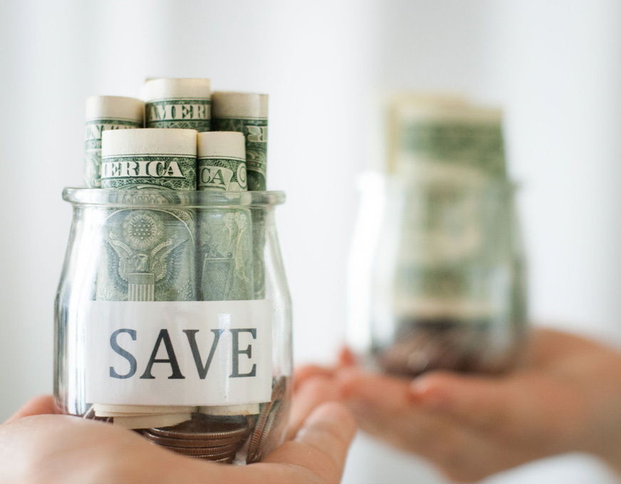
Saving Money
Saving money means you are choosing not to spend that money right now.
Notes:
People save money for different reasons.
Read Slide
Saving money means you can have money to spend in the future.

Slide 4

What Is a Savings Plan?
A savings plan helps you set aside money to buy or pay for something in the future.
Notes:
Read Slide
Saving money can also help you stay out of debt.

Slide 5

Why Save Money?
You can save money to buy something you want in the future that may be more expensive than you have the money to pay for now.
Notes:
Read Slide
What is something you would save your money for?

Slide 6

Why Save Money?
Part two
You can save money for unexpected expenses.
Notes:
Read Slide
An unexpected expense could be an unplanned repair to your home or car.
An unexpected expense could be replacing your broken television or computer.

Slide 7

Why Save Money?
Part three
You can save money for emergencies.
Notes:
Read Slide
A serious illness or accident can be an emergency cost.
Losing your job can be an emergency cost.

Slide 8
Getting Started
Notes:
Let’s talk about how to get started Saving!

Slide 9
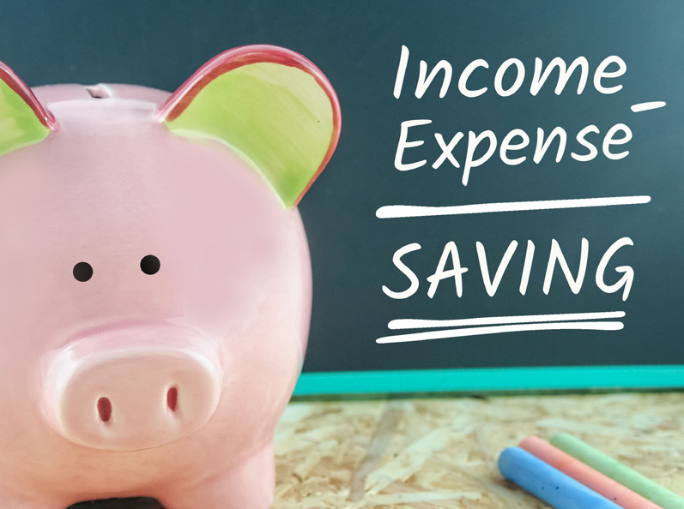
Start by keeping track of how much money you have coming in and going out.
Notes:
If you keep a budget, you can see how much money you have left after paying your expenses.
If there is extra money after paying your expenses, you can decide how much of that money you want to save.

Slide 10

Ways to Save Money
Keep track of your expenses
Include “savings” in your budget
Notes:
Read Slide
List your savings amount with your other expenses in your budget each time.
Share that we will discuss budgeting in a different training.
Budget is listing your income and expenses. A budget helps you determine how much money you have each pay period.

Slide 11

Ways to Save Money part two
Set a savings goal
Decide what is most important
Notes:
Read Slide
A goal could be saving enough money for a:
down payment to buy a home
vacation
guitar

Slide 12

Ways to Save Money part three
Choose the right tools for saving:
  Savings account
  Savings bonds
  Certificates of Deposit (CD)
  Money Market deposit accounts
Notes:
Read Slide
Your bank or financial advisor can help you choose a savings tool that will work for you.
Watch your savings grow.
Co-trainer can share: A financial advisor is someone who can help you make decisions with your money.

Slide 13
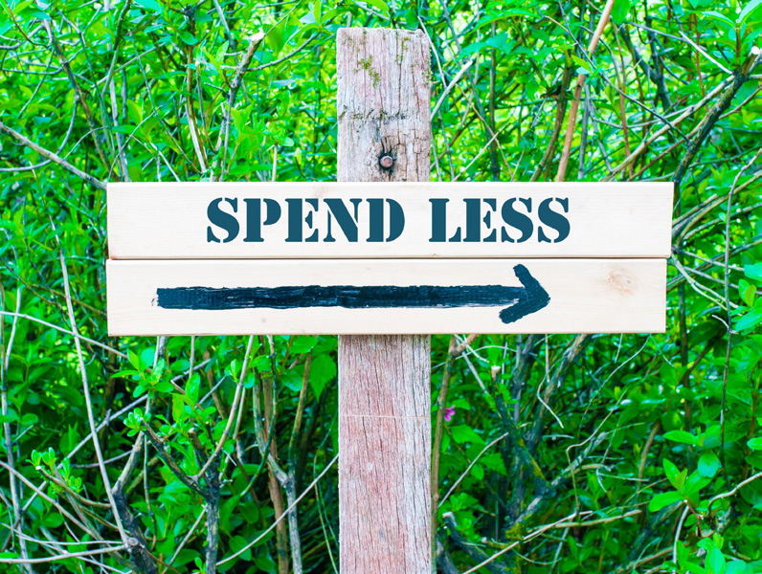
Ways to Save Money part four
Look closely at your monthly spending
Cut out buying things you don’t really need.
Notes:
One way to save more money each month is to spend less. How can you cut spending?
Read Slide

Slide 14
How Can I Save Money?
Notes:
Read Slide

Slide 15

Bank
A bank has different types of accounts where you can put money.
Notes:
Read Slide

Slide 16
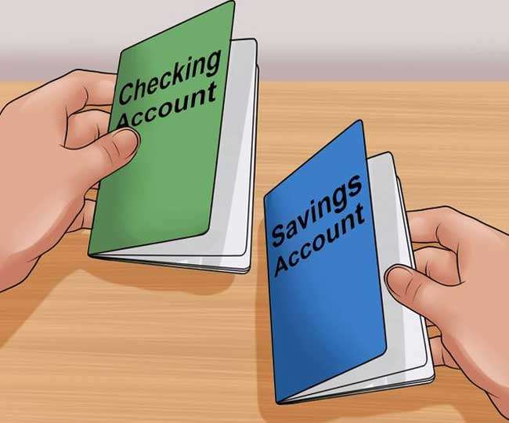
Bank part two
A checking account can be for money that is spent right away on bills or other expenses.
A savings account can be for money you want to save for later.
Notes:
Read Slide
How many of you have bank accounts? What kind?

Slide 17

Bank part three
The bank keeps your money safe.
If something happens to the bank, there is insurance to protect your money.
Notes:
Read Slide
A savings account is a safe place to keep your money.

Slide 18

How Does My Savings Account Grow?
Your savings account grows when:
  You add money
  The bank adds interest
Notes:
Read Slide

Slide 19
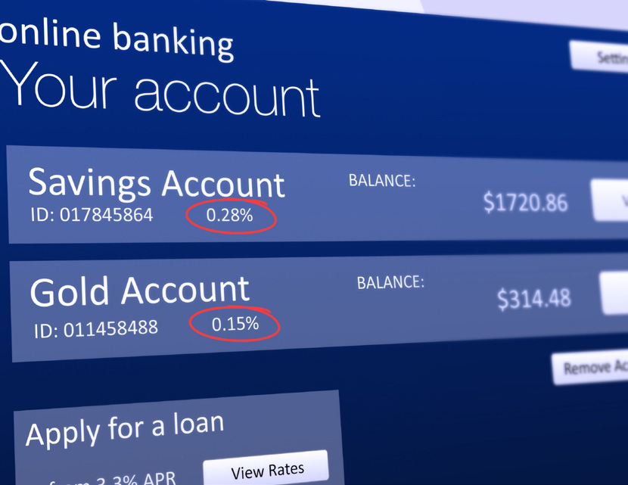
What Is Interest?
Interest is extra money the bank pays you for keeping your money in their bank.
Notes:
Read Slide
The bank pays a rate, or percentage, of the money you have in your account back to you.
The more money in your savings account, the more interest you get paid.

Slide 20

What Is Interest? continued
Interest rates on savings accounts are not very high. But savings accounts are a secure way to slowly grow your money.
Notes:
Read Slide
While interest rates in savings accounts aren’t as high as investment products, they are more secure because they are federally insured.
This means that, even if a bank closes, you are guaranteed to keep your money.
Co-trainer can share: Interest rates for a savings account are low and the money does not grow quickly.

Slide 21

Savings vs. Investing
Savings and investing are two different ways to save money.
Each will help you build financial habits and develop a savings plan.
Notes:
When getting ready to create a savings plan, where do you put your money?
Do you put your money in a savings account or invest it in something?
Read Slide

Slide 22
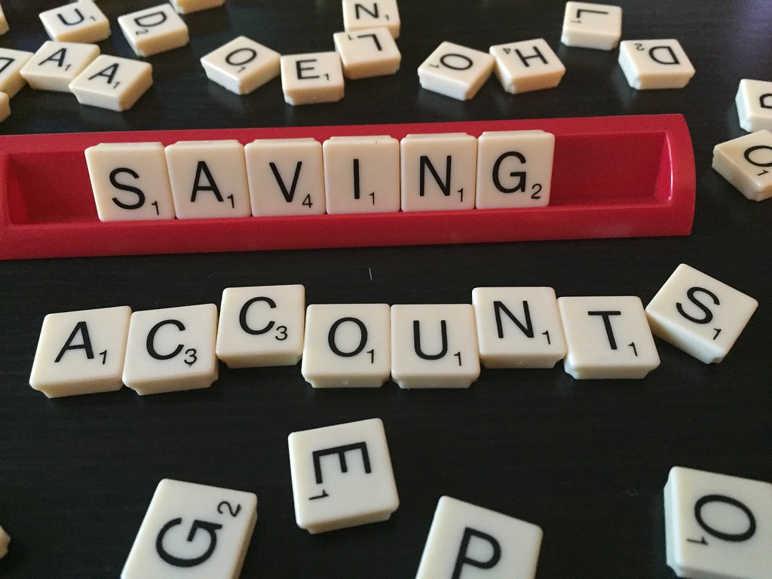
Savings
Your money in a savings account can only grow.
Notes:
Read Slide
Savings accounts are safe places to put your money. Your money is safe and grows slowly with the interest the bank adds.

Slide 23

Investing
Investing means you buy a share in a company or invest in something.
When the company makes money, you get more money added to what you invested.
Notes:
Read Slide

Slide 24

Investing continued
With investing, you can lose money.
Notes:
If the company you invest in loses money, you lose money too.

Slide 25
You can decide how much risk you want to take with your money.
Notes:
Read Slide

Slide 26
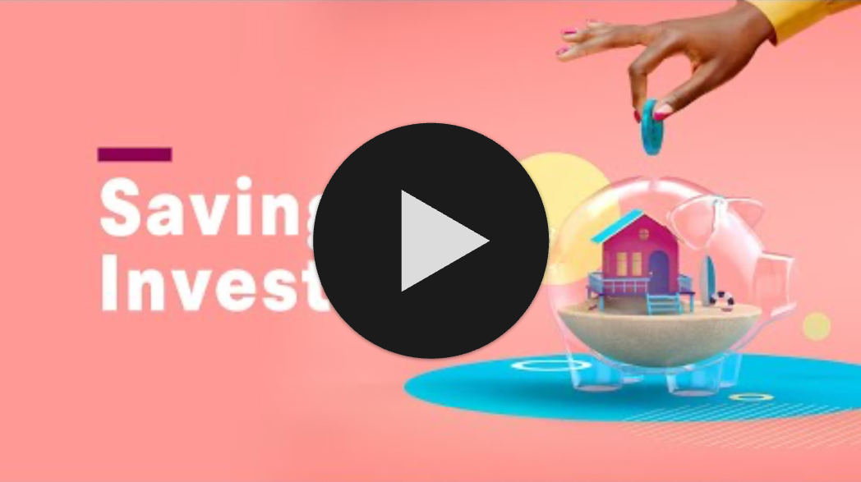
Saving and Investing: A Video
Ctrl + Click on the image to watch the video on YouTube!
Notes:
This is a video on Savings vs. Investing.
https://www.youtube.com/watch?v=DcFKLOWsSRg (1:59)

Slide 27

Charting the LifeCourse is a framework and set of tools that can help you organize your ideas, vision and goals.
Notes:
Read Slide

Slide 28
Vision & Trajectory for a Good Life
Friends, family,
job I like, home, health, choice, freedom
Trajectory towards Life Outcomes
Trajectory towards things unwanted
Vision of What I Don’t Want
Notes:
What kinds of things do you want for YOUR good life?
A TRAJECTORY is a path that will either lead you toward the good life or toward things you don’t want.
If thinking about your Savings Plan. How could you use this trajectory?

Slide 29
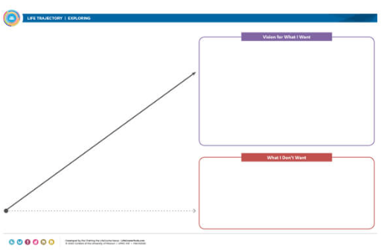
Charting the
LifeCourse Trajectory
The Charting the LifeCourse trajectory is a goal setting tool to help you focus on what you want for your savings plan.
Discuss the scenarios and complete a CtLC Trajectory based on the savings plan.
Notes:
What is your plan for saving money? What would you like to save money for?
The Charting the LifeCourse trajectory is a tool to help you focus on what your goal is for Saving money.
Read the slide and refer to the trajectory tool. Put the participants in groups to practice using a trajectory.
Give the groups 10 minutes to complete the activity.
Pull the group back together to share out what their group determined.

Slide 30
Resources
How to Save Money: 23 Tips that Work
http://www.ramseysolutions.com/budgeting/the-secret-to-saving-money
Eight Simple Ways to Save Money
http://bettermoneyhabits.bankofamerica.com/en/saving-budgeting/ways-to-save-money
Video: How to Set Up Your Emergency Fund
https://www.youtube.com/watch?v=IrA2xv4vEPM
Charting the LifeCourse Daily Life and Employment
https://www.lifecoursetools.com/lifecourse-library/exploring-the-life-domains/daily-life-and-employment/
Notes:
These resources were used to create this training.
It is important to understand savings and investing.
This training goes along with the EZ-Reader Learning About Savings and Investing
Thank you for joining us.

Slide 31
Acknowledgements: Community Life Guide: A Project of Ohio Department of Developmental Disabilities. Developed by Altarum and Life Course Nexus Training and Technical Assistance Center, UMKC institutes for Human Development, UCEDD

