Slide 1

Understanding Health Care Transition
Notes:
This training will discuss Transitioning to Adult HealthCare.
We will refer to the EZ-Reader Understanding Health Care Transition throughout the training.
A learning activity will be completed in the training.
Please ask questions as we go through.

Slide 2
Learning Objectives
The participants will:
Define the difference between childhood and adult health care
Identify ways to transition to adult health care
Create a transition plan for adult health care
Notes:
In the training today, we will talk about:
The difference between childhood and adult health care.
Ways to transition from childhood to adult health care.
How to set goals for your health care as an adult.
This looks differently for many people.

Slide 3

When You Are Young
Parents take care of many things.
What are some things parents do?
Notes:
Parents help and decide things for you.
What are ways your parents take care of you?
Make dinner
Teach me how to build . . .
Take you to doctor appointments

Slide 4

Health Care When You Are Young 1
Your parents take care of your health care.
They. . .
  schedule appointments with doctors and other specialists.
  pay for your health care.
Notes:
Read Slide

Slide 5

Health Care When You Are Young 2
Parents make decisions about your health care.
They. . .
  may decide if you have surgery.
  may decide if you take certain medicine.
  may talk to your doctor for you.
Notes:
Read Slide
What are other decisions your parents make about your health care?
Do I need braces?
Do I need glasses?
Do I need to take vitamins?

Slide 6

What Is Health Care Transition?
As you get older, you can start to take charge of your own health care.
Taking charge of your own health care is called Health Care Transition.
Notes:
As you get older, you can start to take charge of your own health care.
This is called Health Care Transition

Slide 7

Health Care Transition
Health Care Transition means moving from childhood health care to adult health care.
This can look different based on your abilities.
Notes:
Transition is a word that means changing from one thing to another.
As you grow, you transition from childhood to adulthood.
Read Slide
**Point out different images

Slide 8

What Do I Need to Know?
Managing your health and wellness is an important part of becoming an adult.
As an adult, you might do everything for your health or just some things.
Notes:
Read Slide
Managing your health and wellness can be a big step in living the life that you want.

Slide 9

How Will It Be Different? 1
As a child, you see a doctor who takes care of children.
  This doctor is called a Pediatrician.
As a child, you could also see a Family Physician or General Practitioner.
  A Family Physician is a doctor that can take care of the whole family.
Notes:
Read Slide

Slide 10

How Will It Be Different? 2
As an adult, you will need to see a new doctor who takes care of adults.
Notes:
Read Slide
That means you will leave your pediatrician and go to a different doctor.
Or, If you see a family doctor, you will just need to talk to the doctor about how you can change your health care to adult health care.

Slide 11

How Will It Be Different?
As a child, your parents come with you to see the doctor.
As an adult, you can see the doctor by yourself.
Notes:
Read Slide
As an adult, you can decide things about your health care.
You can talk to and ask other people for help with your health care.

Slide 12

What is Health Care Transition (HCT)
Notes:
This is a video to help you make the transition from childhood to adult health care. (2:30)

Slide 13

What Can I Do Now?
Things you can do to get ready for this change in health care.
Talk to your parents about how you can do more health care tasks.
Ask questions about your health care at doctor appointments.
Notes:
There are many resources you can review that will help you talk with your parents about what you should be doing now.
Check out the resources at the end of this training.

Slide 14

Healthy Living LifeCourse Tools
The Healthy Living LifeCourse tools will help you have the conversations, explore your vision and plan experiences and supports to achieve your healthy life.
Notes:
Charting the LifeCourse is a framework and set of tools that can help you organize your ideas, vision and goals. Living a healthy life and keeping your body in good working order can take some planning and effort.
Read Slide

Slide 15
Vision & Trajectory for a Good Life
Friends, family,
job I like, home, health, choice, freedom
Trajectory towards Life Outcomes
Trajectory towards things unwanted
Vision of What I Don’t Want
Notes:
What kinds of things do you want for YOUR good life?
TRAJECTORY is the path that will either lead you toward the good life or toward things you don’t want. Trajectory isn’t always straight
VISION and TRAJECTORY can be very broad or very specific and time limited.

Slide 16
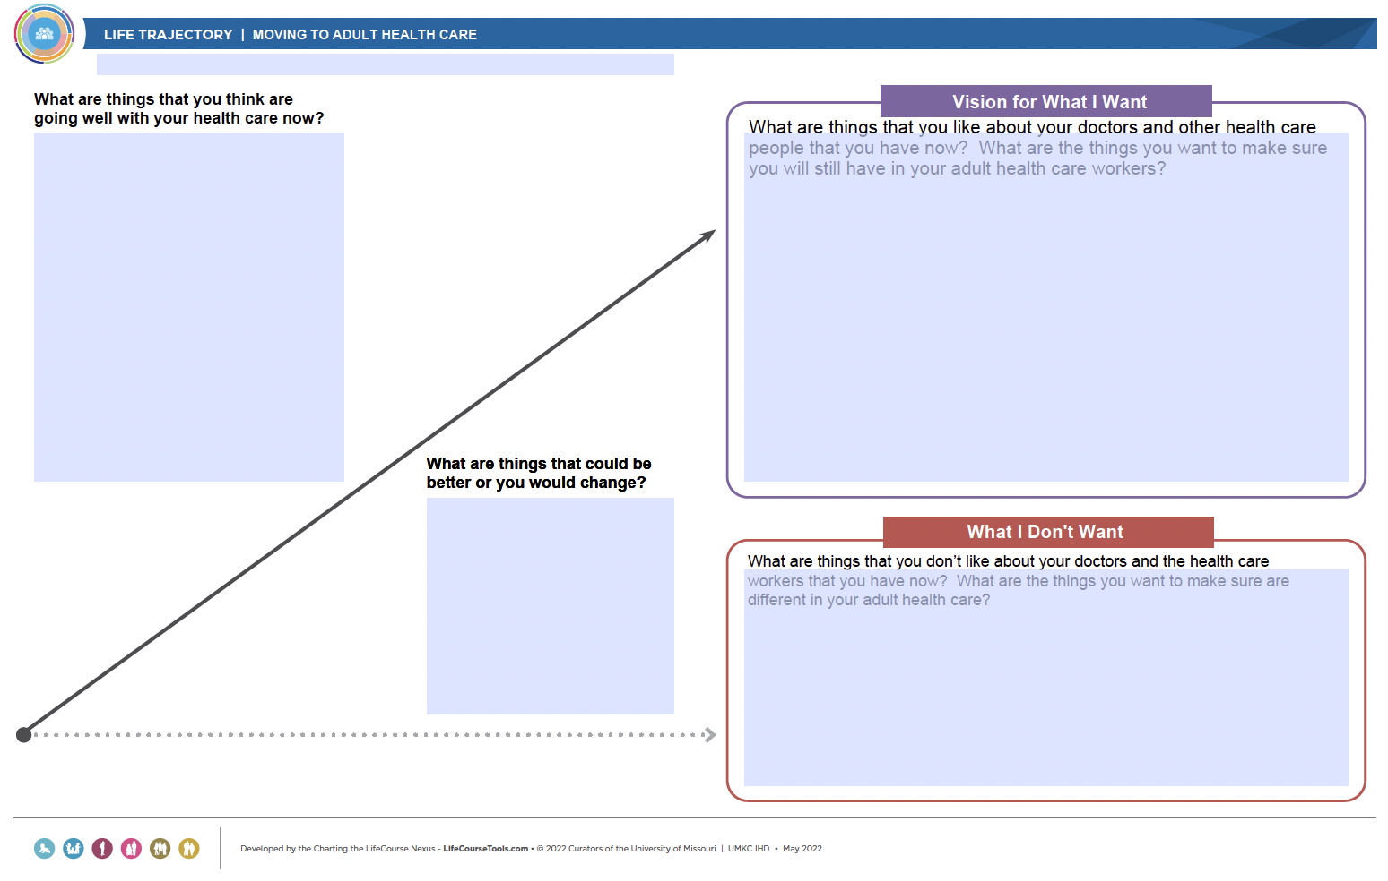
Charting the LifeCourse Trajectory
Notes:
CtLC trajectory
The participants can talk about the trajectory in a small group or whole group to practice. Ideas can be shared, or you can discuss a scenario to have participants create a HealthCare trajectory.
Read through each section and give ideas.
What are things that you think are going well with your health care now?
What are things that could be better, or you would change?
What are things that you like about your doctors and other health care people that you have now? What are the things you want to make sure you will still have in your adult health care workers?
What are things that you don’t like about your doctors and the health care workers that you have now? What are the things you want to make sure are different in your adult health care?

Slide 17
Resources
Got Transition Website
https://www.gottransition.org/resources-and-research/youth-and-families.cfm
Health Care Transition Timeline
Questions to ask your child’s doctor about transitioning to adult health care
What is Health Care Transition and what does it mean for you? Video
Charting the LifeCourse Healthy Living Tools
https://www.lifecoursetools.com/lifecourse-library/exploring-the-life-domains/healthy-living/
Notes:
These resources were used to create this training.
It is important to understand how to transition to adult health care. Understanding what you need to do when talking with doctors about your health care.
This training goes along with the EZ Reader Understand Health Care Transition.
Thank you for joining us.

Slide 18

Acknowledgments

