Slide 1
Understanding Your Rights
Notes:
This training will discuss your legal rights as you transition to adult health care.
We will refer to the EZ-Reader Understanding Your Rights throughout the training.
A learning activity will be completed in this training.
Please ask questions as we go through.

Slide 2
Learning Objectives
The participant will:
Define their rights as they transition into adult health care
Identify reasonable accommodations needed for adult health care
Recognize the supports needed to make adult health care decisions
Notes:
In the training today, we will talk about:
Your rights as a young person transitioning into adult health care.
The reasonable accommodations you may need when accessing adult health care.
The supports you may need as you make decisions around adult health care.
This looks differently for many people.

Slide 3
Health Care is a Right
Having access to and using health care is your right.
Notes:
Read Slide
Everyone has the right to quality health care.
Building a trusting relationship with your doctors and other health care workers is your right.

Slide 4
Americans with Disabilities Act (ADA)
ADA is a law that protects you from being treated differently because of your disability.
Notes:
Read Slide

Slide 5
Reasonable Accommodations 1
A reasonable accommodation means to make changes to help give access.
Notes:
ADA says reasonable accommodations must be available when going to the doctor.
Read Slide

Slide 6
Reasonable Accommodations 2
Physical accommodations help you get into or around a health care building.
Notes:
Always let your doctor’s office know if you need additional physical accommodations. Most business are ADA compliant. Meaning, they have ramps, doors that automatically open, etc.
You may need more and communicating the accommodations you need will help you feel supported.

Slide 7
Reasonable Accommodations 3
Language accommodations help you communicate or understand things about health care.
Notes:
Read Slide
Be clear about how you best communicate and understand information.

Slide 8
Reasonable Accommodations 4
Other accommodations can be a longer appointment or getting information in other formats.
Notes:
Read Slide

Slide 9
Your Right to Receive Information
How do you best receive and understand information?
Large print materials
American Sign Language (ASL)
Braille
Plain language
Photos or picture formats
Video or audio recordings
Notes:
Read Slide
Ask participants what reasonable accommodations they need (if they are willing to share).

Slide 10
Your Right to Bring a Support Person
You have the right to bring anyone you need to support you when you visit a doctor.
Ask someone you trust to support you.
Family member
Close friend
Support staff
Notes:
Read Slide
You can tell the person exactly how to help at your doctor visit.

Slide 11
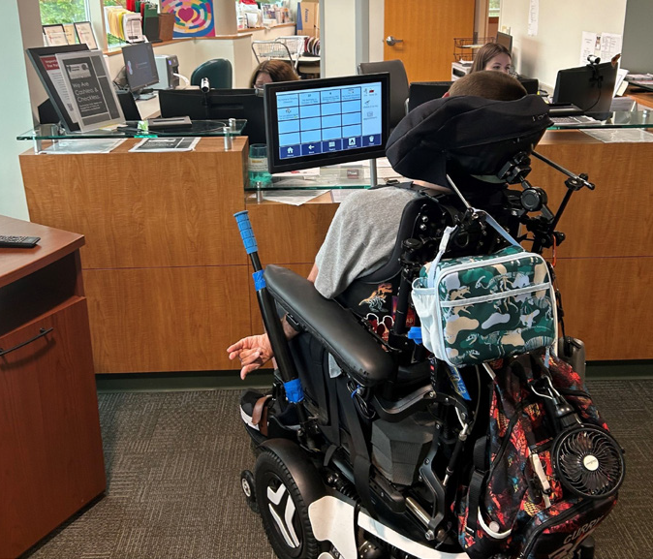
How Can a Support Person Help? 1
A support person can. . .
help with getting into and out of the health care setting.
remind you of things to talk about at the health care appointment.
help by taking notes at the health care appointment.
Notes:
Read Slide

Slide 12
How Can a Support Person Help? 2
A support person can. . .
discuss pros and cons of a medication or treatment.
help you ask the doctor questions.
Notes:
Read Slide

Slide 13
Respect
What does it mean to be treated with respect by doctors and health care workers?
Notes:
The doctor must listen to you and ask questions if they do not understand.
The doctor should respect your thoughts and beliefs.
The doctor and other staff must respect your privacy.

Slide 14
Your Right to Privacy
Right to privacy means you can see the doctor by yourself.
The doctor cannot talk to anyone about your health care unless you say it is okay.
Notes:
Read Slide
The doctor must respect your personal privacy during exams, treatments or personal care.

Slide 15
Your Right to Choose Health Care
It is your right to say yes or no to health care.
It is your right to have a health care plan that you agree with.
Notes:
Read Slide
It is your right to say no to health care treatment even if it might save your life.

Slide 16
Your Right to Informed Consent
Informed consent means you have the right to understand before saying yes to treatment.
Notes:
Read Slide
Ask as many questions as you need about your health care until you understand.
It is your job to tell the doctor if you do not understand.

Slide 17
Your Right to Private Health Care
You have the right to look at your health care records.
Notes:
Read Slide
Only your care team and those you give permission may look at your health care records.
You can choose others to look at your health care records.

Slide 18
Your Right to Your Health Care Records
Ask for your health care records in writing.
Email
Letter
Notes:
Read Slide
You must be given a copy of your health care records if you ask.
You could be charged a fee for making copies.

Slide 19
Your Right to End-of-Life Care
You have the right to get information about end-of-life care.
Notes:
Read Slide
You have the right for your end-of-life choices to be respected.
You have the right to receive hospice care for comfort at the end of your life.

Slide 20
Your Right to Be Safe in Health Care Setting 1
You have the right to be safe from any form of abuse during health care.
Notes:
You have the right to be safe from discipline and mistreatment during health care.
Read Slide

Slide 21
Your Right to Be Safe in Health Care Setting 2
Discipline and mistreatment during health care can be a form of:
Restraint
Seclusion
Harassment
Physical Punishment
Notes:
You have the right to be safe from any form of abuse during health care.
Read Slide

Slide 22
Guardianship 1
Guardianship means someone has the legal right to make decisions for you.
Notes:
Read Slide
You may not be the final decision maker if you have a guardian.
Being safe and asking for reasonable accommodations are your rights even if you have a guardian.

Slide 23
Guardianship 2
A guardian can help you learn more about making decisions for health care.
A guardian can help you gain skills so you may not need a guardian in the future.
Notes:
A guardian should honor and respect your choices or preferences when possible.

Slide 24
Summary
Today, you learned about your health care rights and how to communicate your health care needs.
When thinking about managing your adult health care, supported decision making tools can help you in the process.
This Photo by Unknown Author is licensed under CC BY-NC
Notes:
Read Slide
Supported Decision making is about helping people make their own decision by using a variety of supports. Supported Decision Making tools can help a person understand their choices, ask questions and communicate their decisions to others.

Slide 25
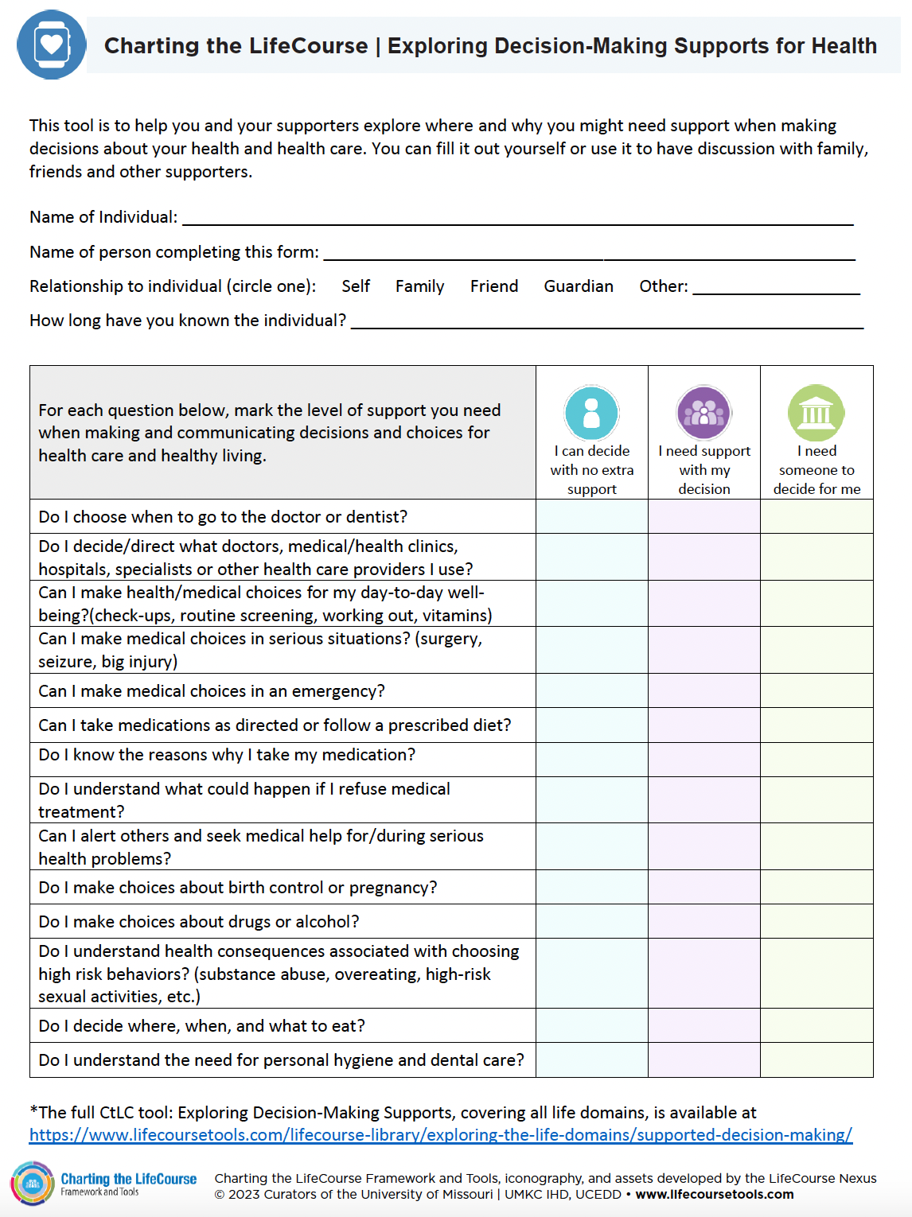
Exploring Decision Making Supports
This tool can help you make choices and decisions about your health care.
It can help determine how much support might be needed for making and communicating decisions.
Notes:
This Supported Decision-Making Tool focuses on the Health Living Life Domain. For each question, decide the level of support you need when making and communicating decision and choices about your Health Care.
You have 3 choices, ”I can decide with no extra support. I need support with my decision. I need someone to decide for me.”
The participants can review this and take it with them to complete on their own. You can split into groups to have conversations about the tool or talk through as a whole group.
It may be helpful to read through the questions and have the participants think about where they fall.

Slide 26
Resources
Charting the LifeCourse: Supported Decision Making
www.lifecoursetools.com/lifecourse-library/exploring-the-life-domains/supported-decision-making/
Cincinnati Children’s Hospital Patient Rights
www.cincinnatichildrens.org/patients/visit/visiting-guidelines/rights
Your Rights Under HIPAA
www.hhs.gov/hipaa/for-individuals/guidance-materials-for-consumers/index.html
Frequently Asked Questions About Durable Powers of Attorney for Health Care
www.lawhelp.org/dc/resource/frequently-asked-questions-about-durable-powe
Advance Directives
www.caringinfo.org/planning/advance-directives/
Notes:
These resources were used to create this training.
It is important to understand how to transition to adult health care. Understanding your rights when talking with doctors about your health care.
This training goes along with the EZ-Reader Understanding Your Rights.
Thank you for joining us.

Slide 27
Resources Continued
Power of Attorney
www.caringinfo.org/planning/advance-directives/power-of-attorney-and-caregiving/
HHS OCR - HIPAA Rights
www.youtube.com/watch?v=FKTHncn-5Vs
HHS OCR - Communicating with Family, Friends, and Others Involved in Your Care
www.youtube.com/watch?v=om2IPAcADas
Abuse Awareness and Prevention
www.lifecoursetools.com/lifecourse-library/exploring-the-life-domains/abuse-awareness-and-prevention/
HIPAA PHI (Protected Health Information): Definition of PHI and List of 18 Identifiers
www.cphs.berkeley.edu/hipaa/hipaa18.html

Slide 28
Acknowledgments

